Slide 1
Language Quickwrite
Imagine that you travel to another country, but cannot understand the language being spoken or writen.
How comfortable would you feel?
How would you attempt to communicate with people?
What does this make you realize about the significance of language and communication?

Slide 2
Afro-Brazilian Art

Slide 3
Characteristics
Influenced by European art styles with elements of African culture such as
Topic of artwork
Use of bright colors
Abstract elements
Use of sculpture
Jewelry and textiles

Slide 4
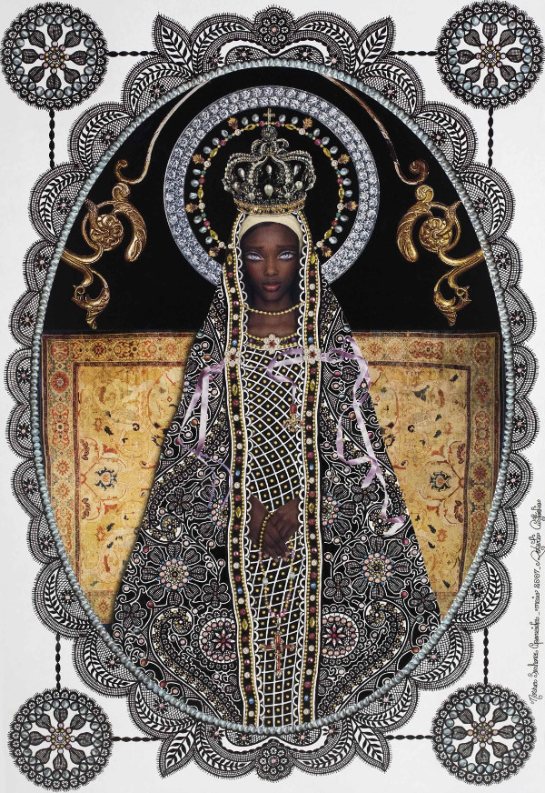
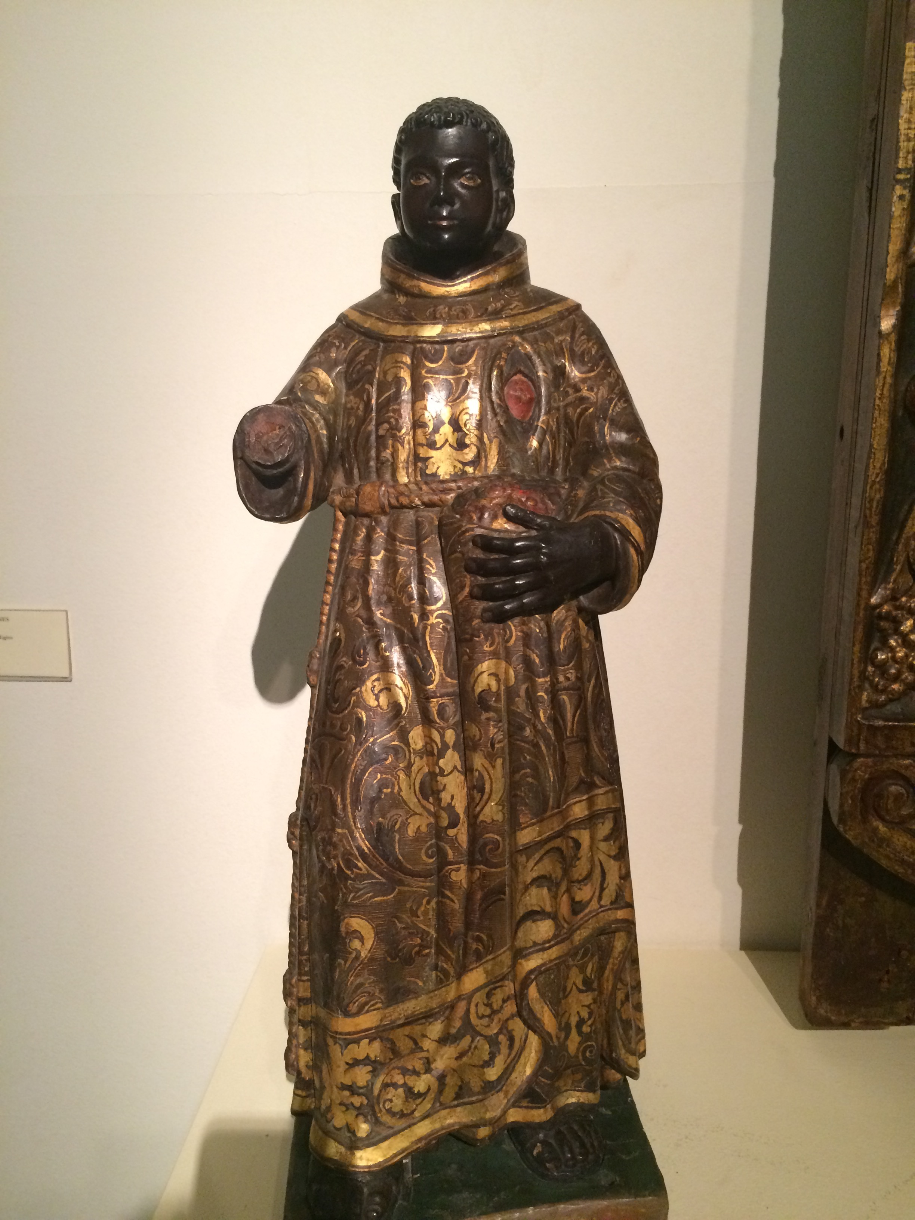
European Influence Example

Slide 5
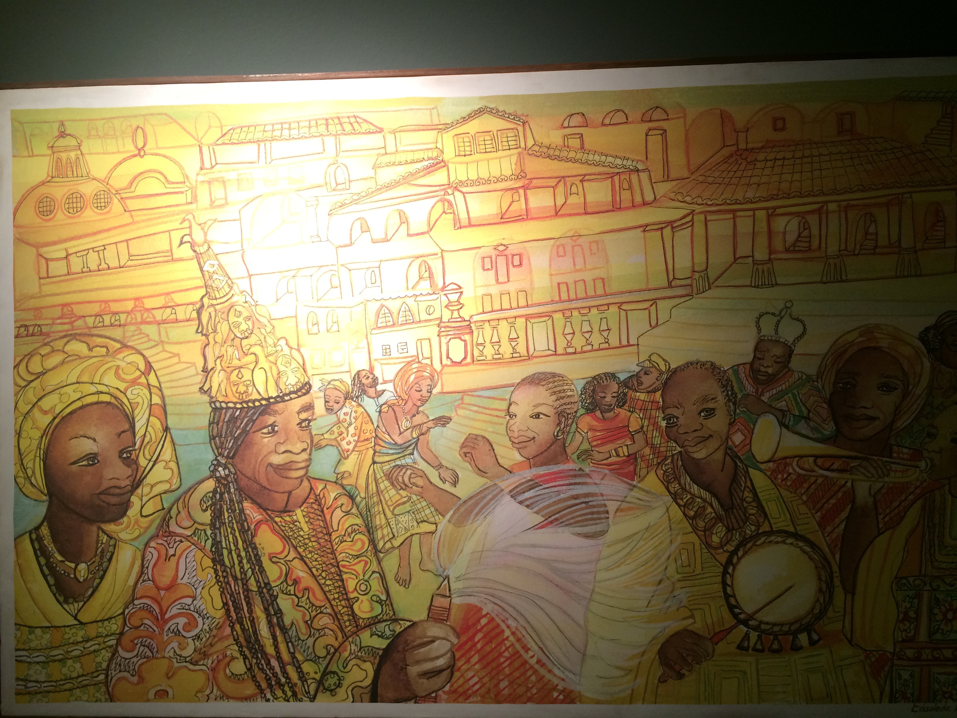
African Culture Example

Slide 6
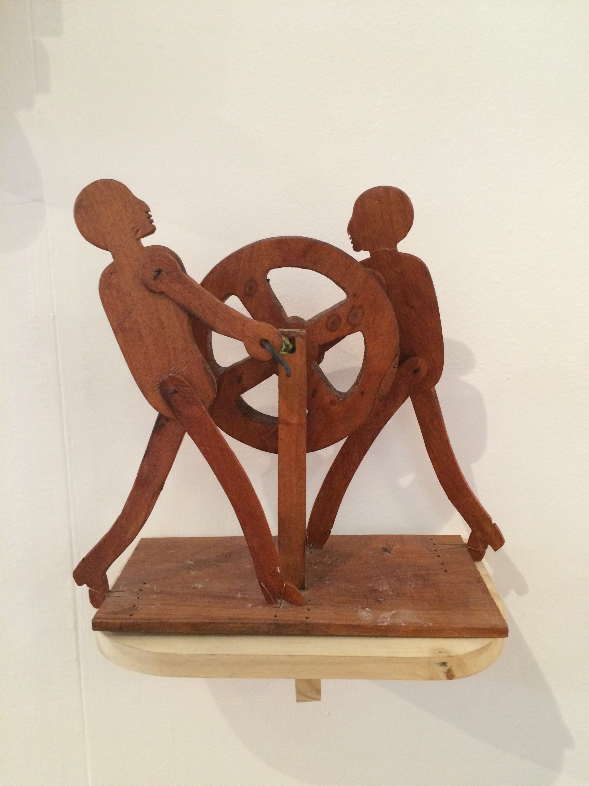
Woodworking Example

Slide 7
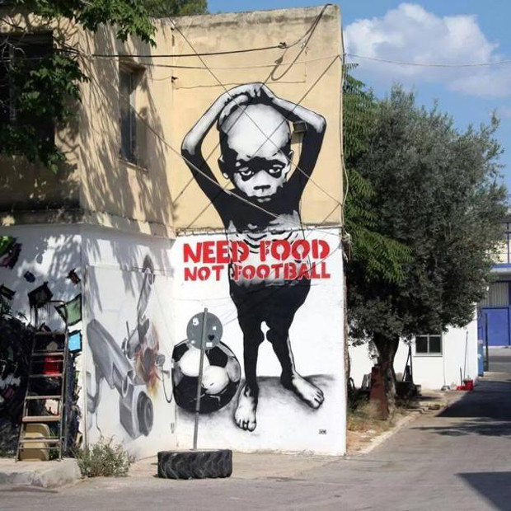
Political Commentary Examples

Slide 8
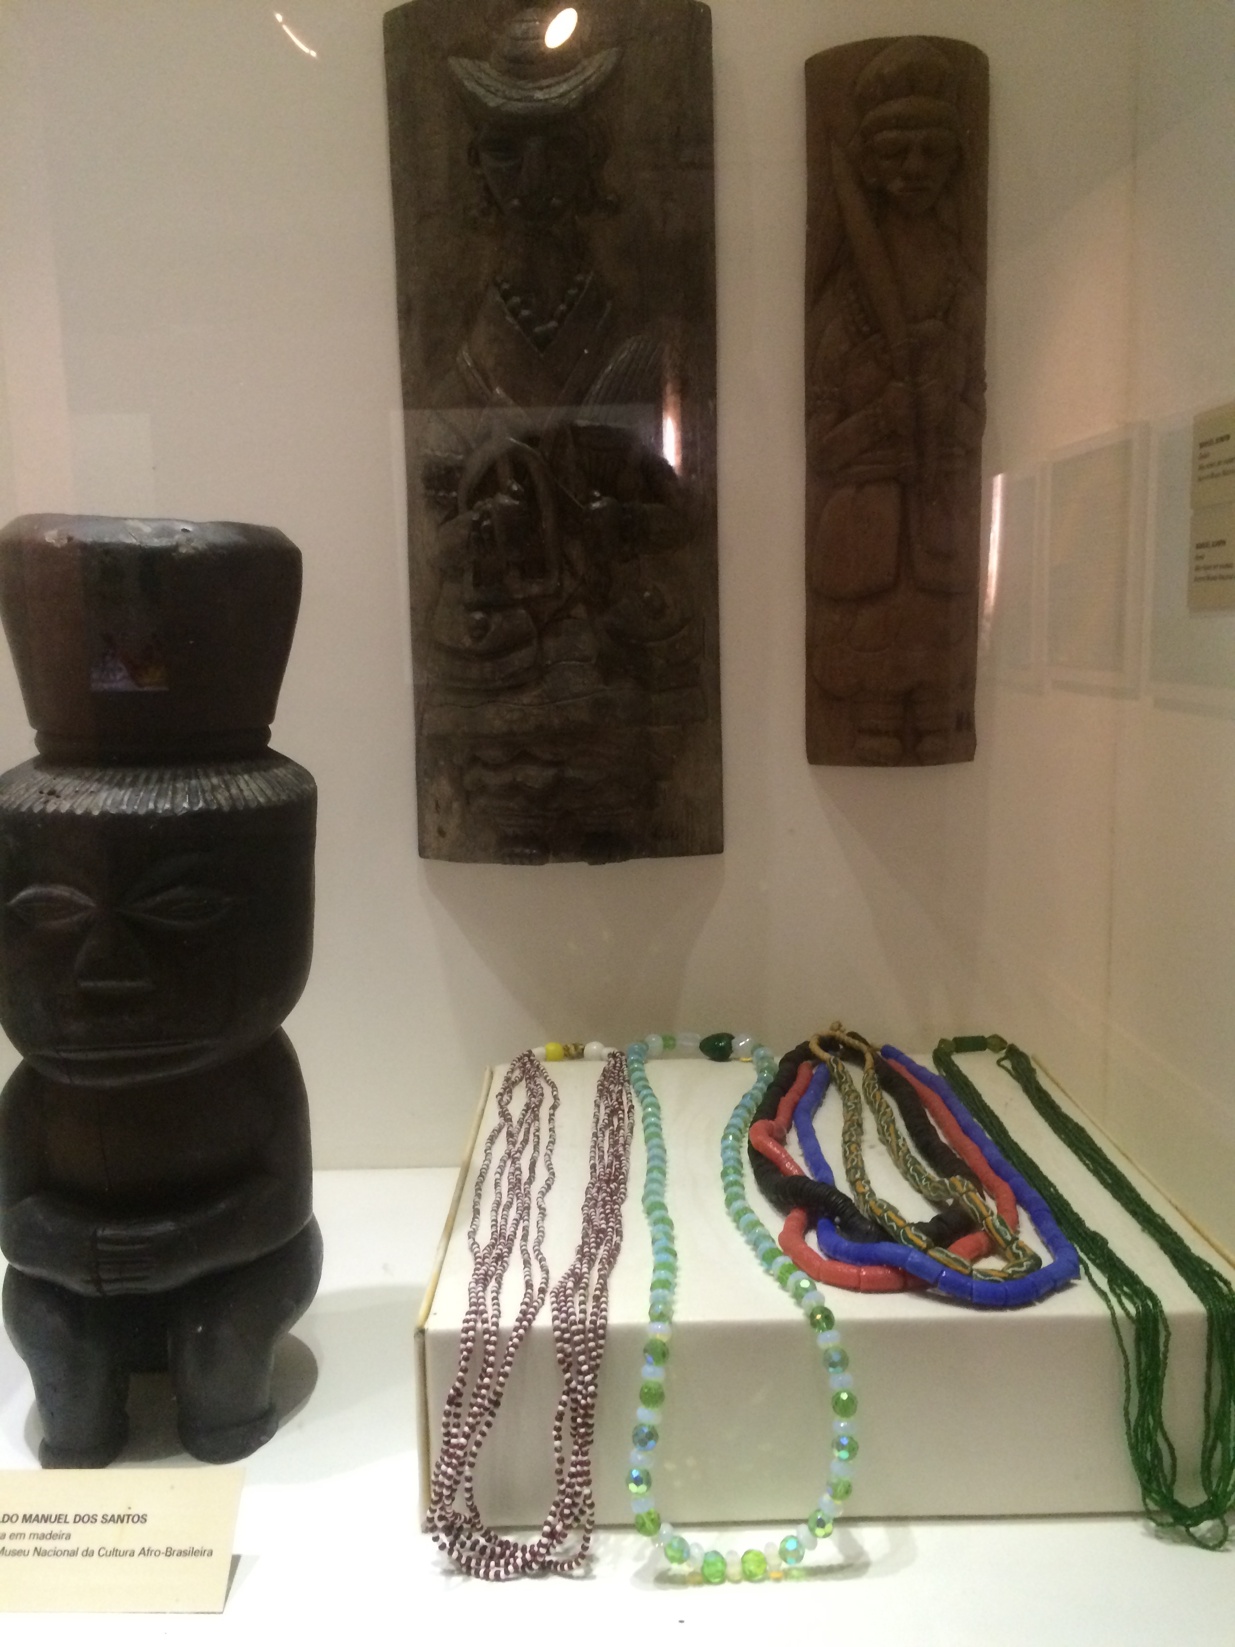
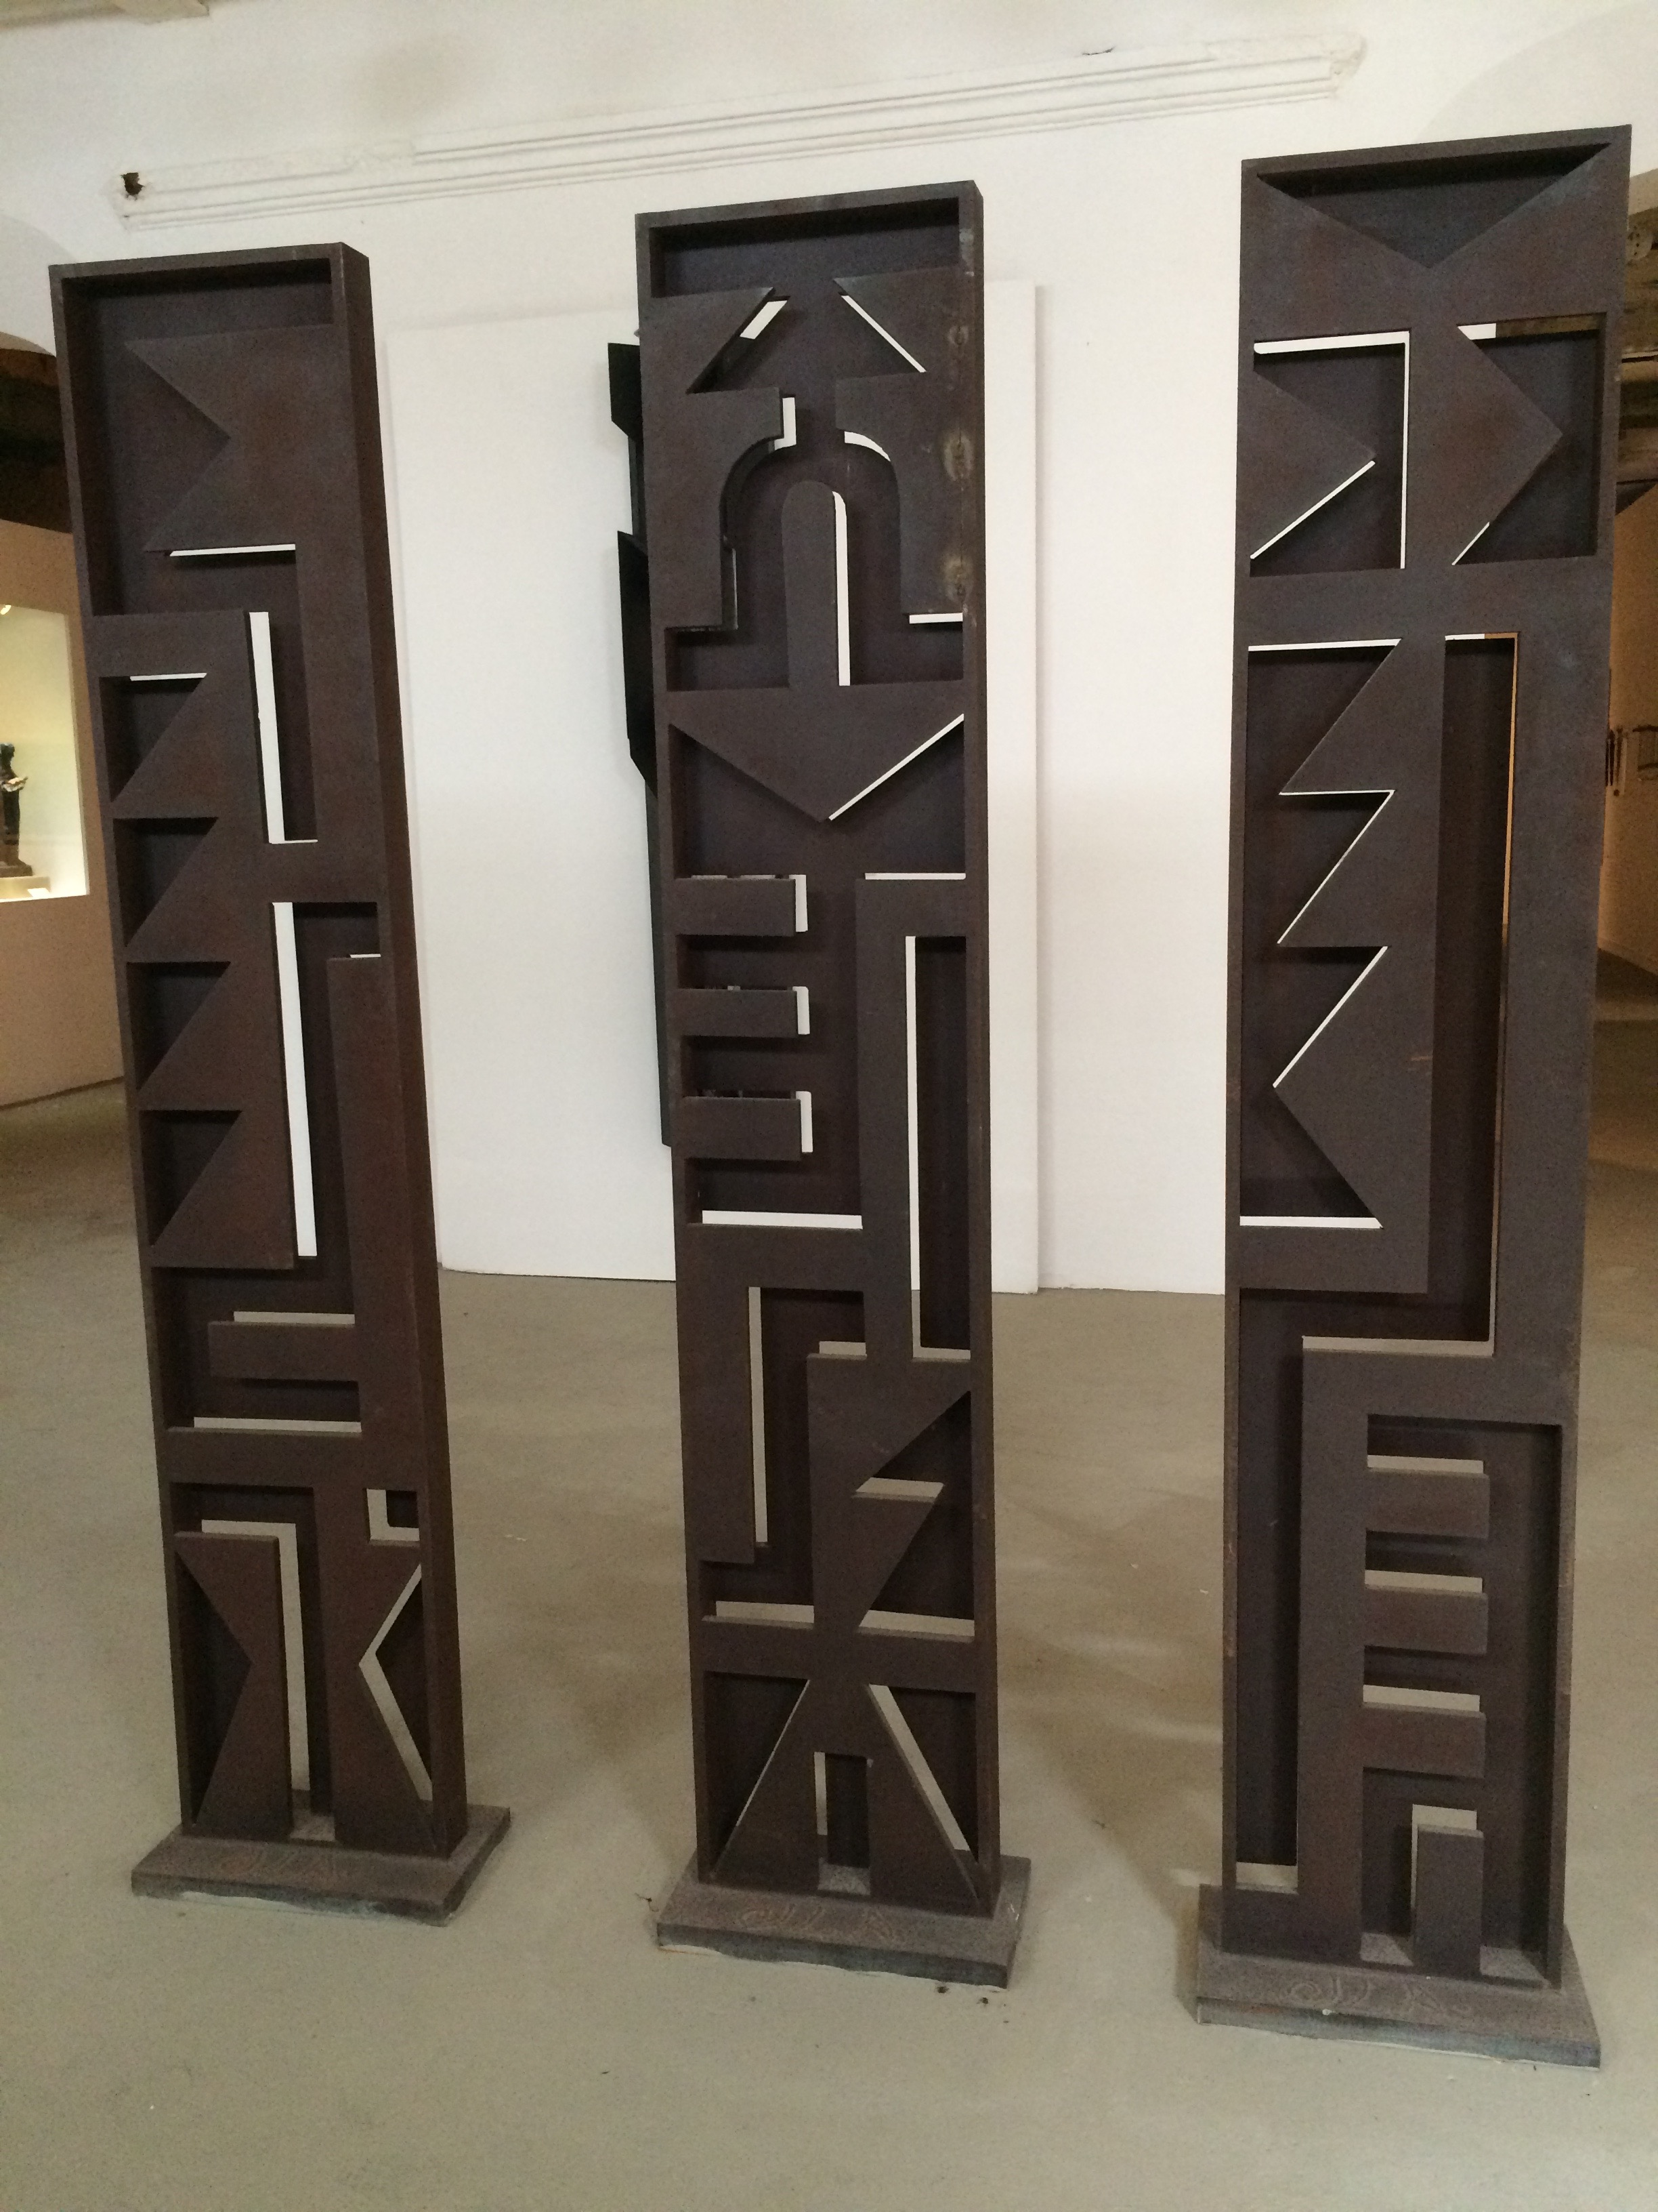
Sculpture Example

Slide 9
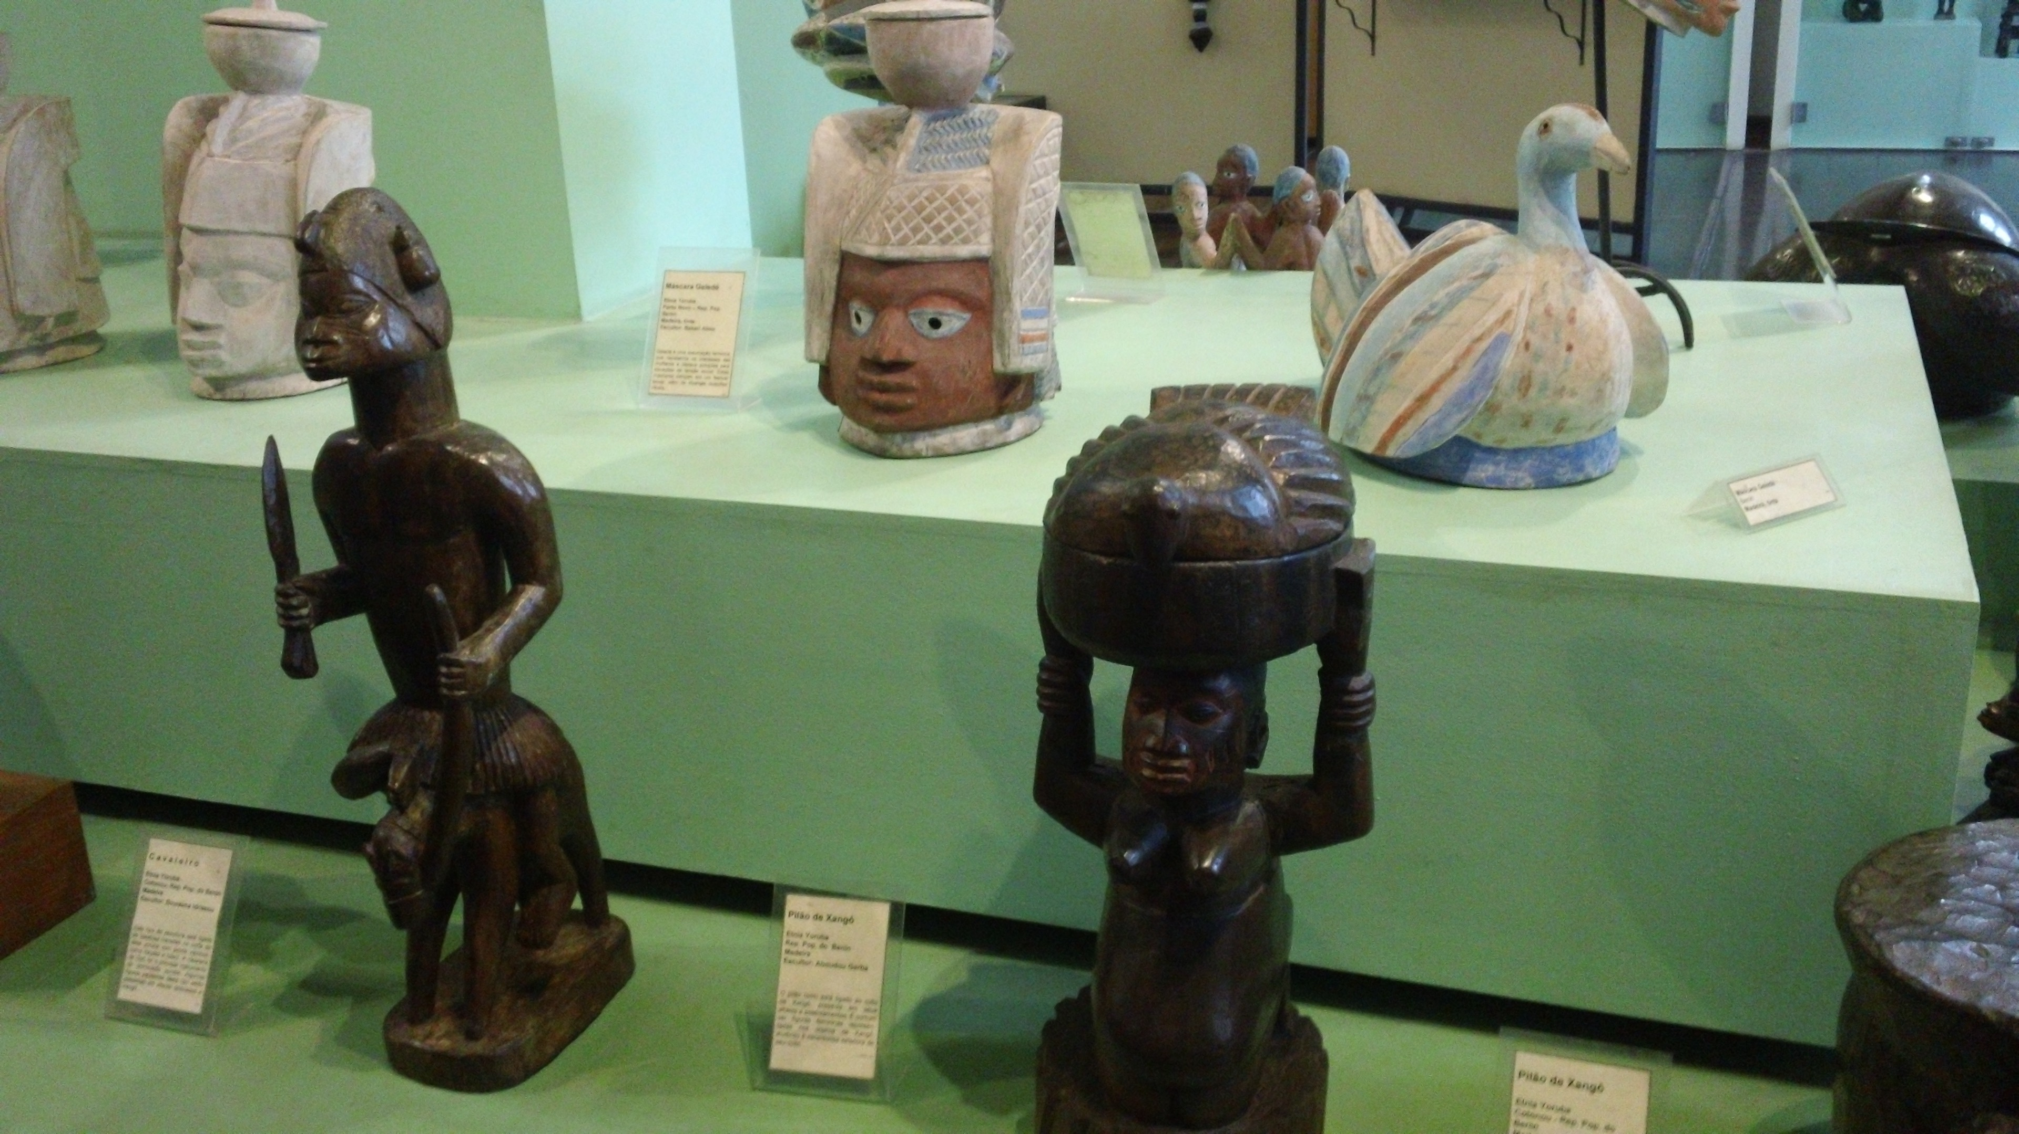
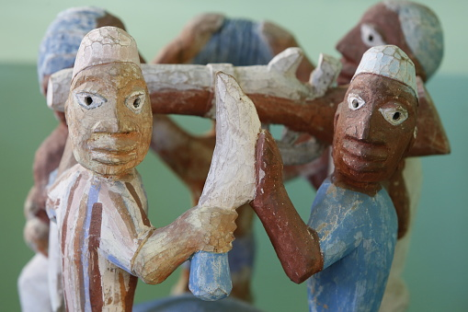
Sculpture Example

Slide 10
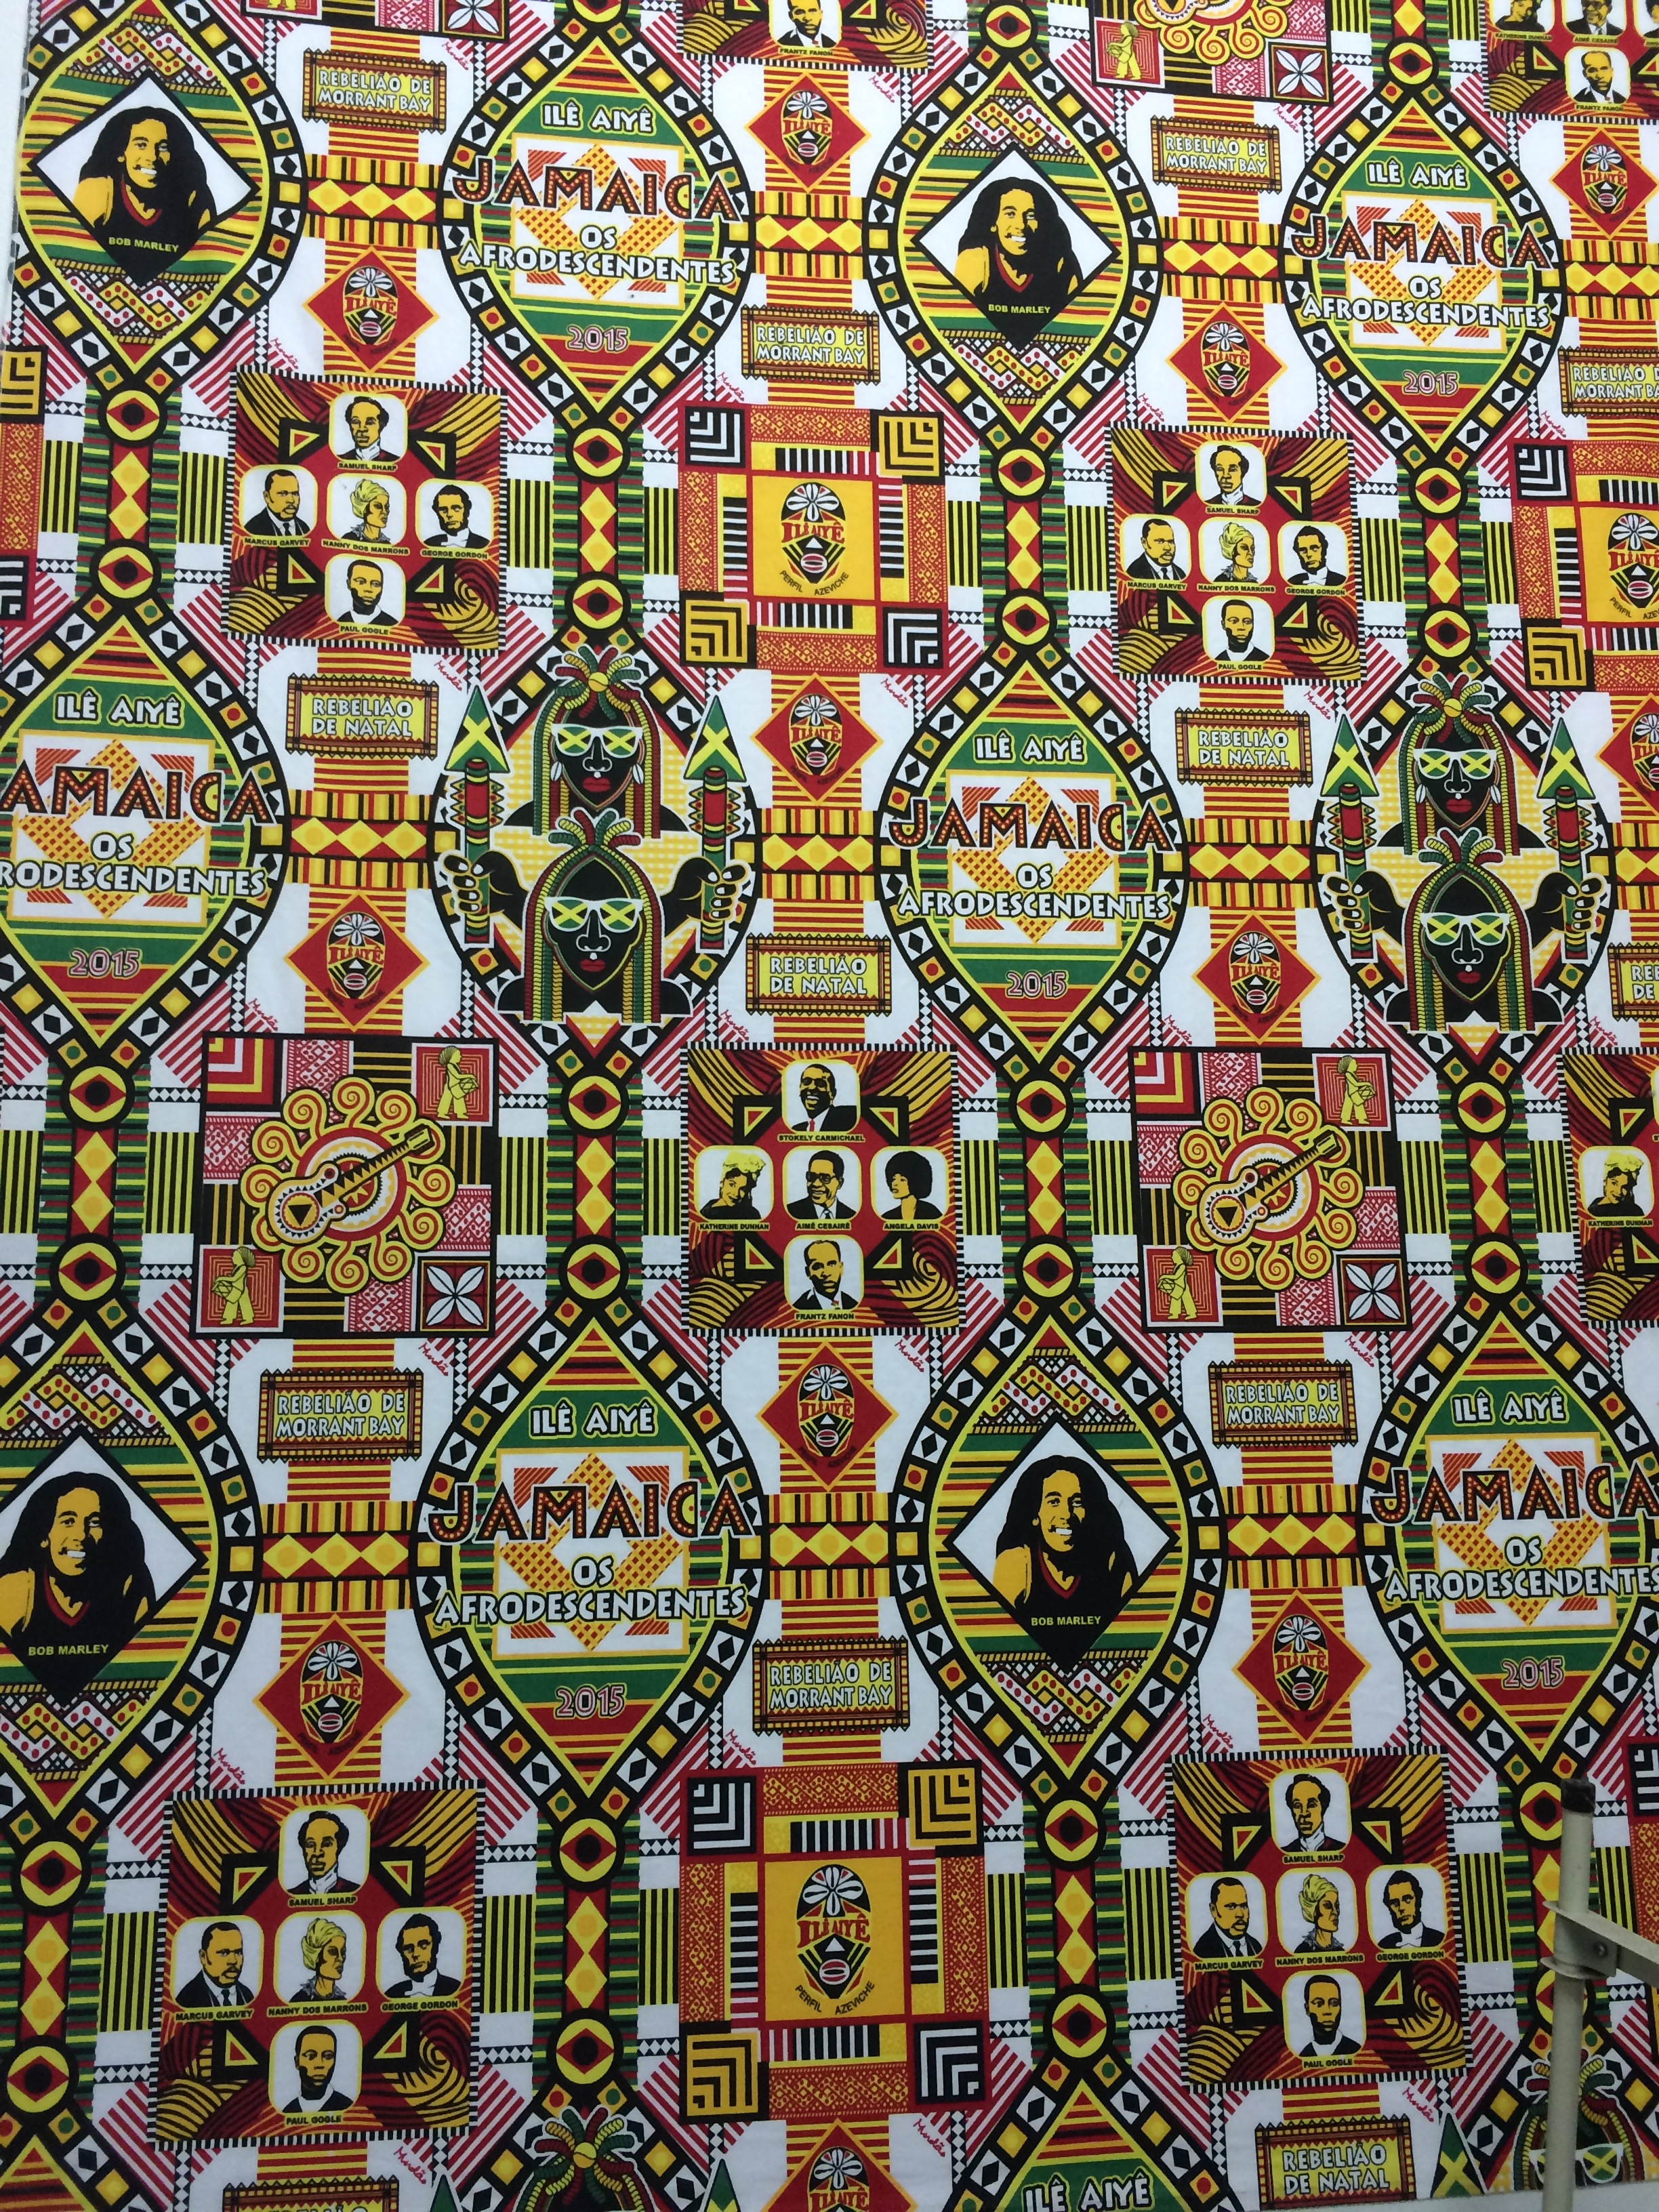
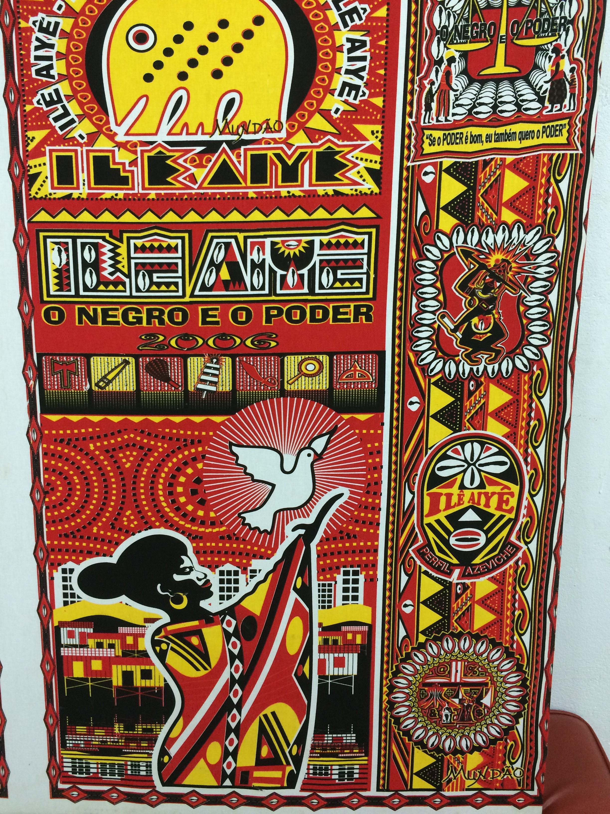
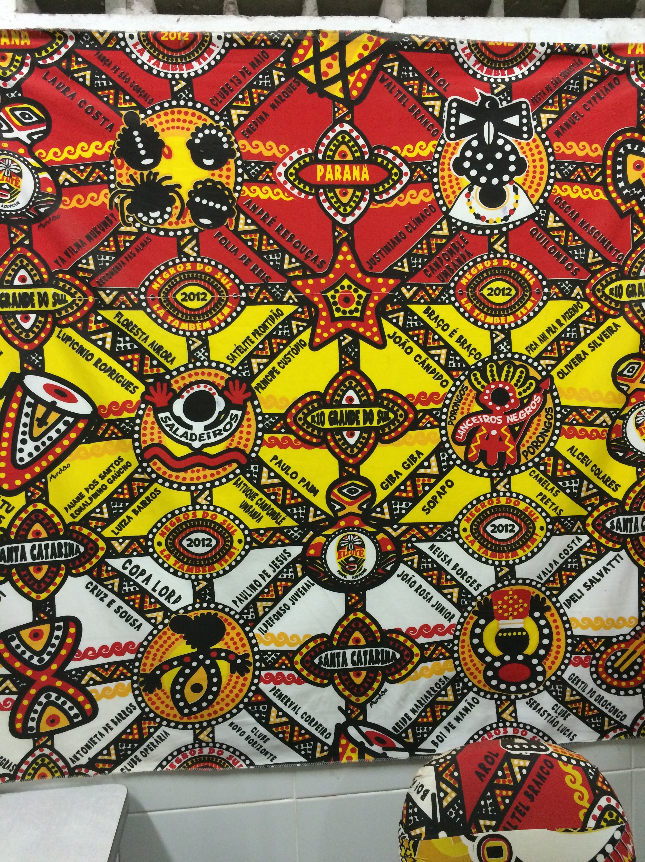
Textile Examples

Slide 11
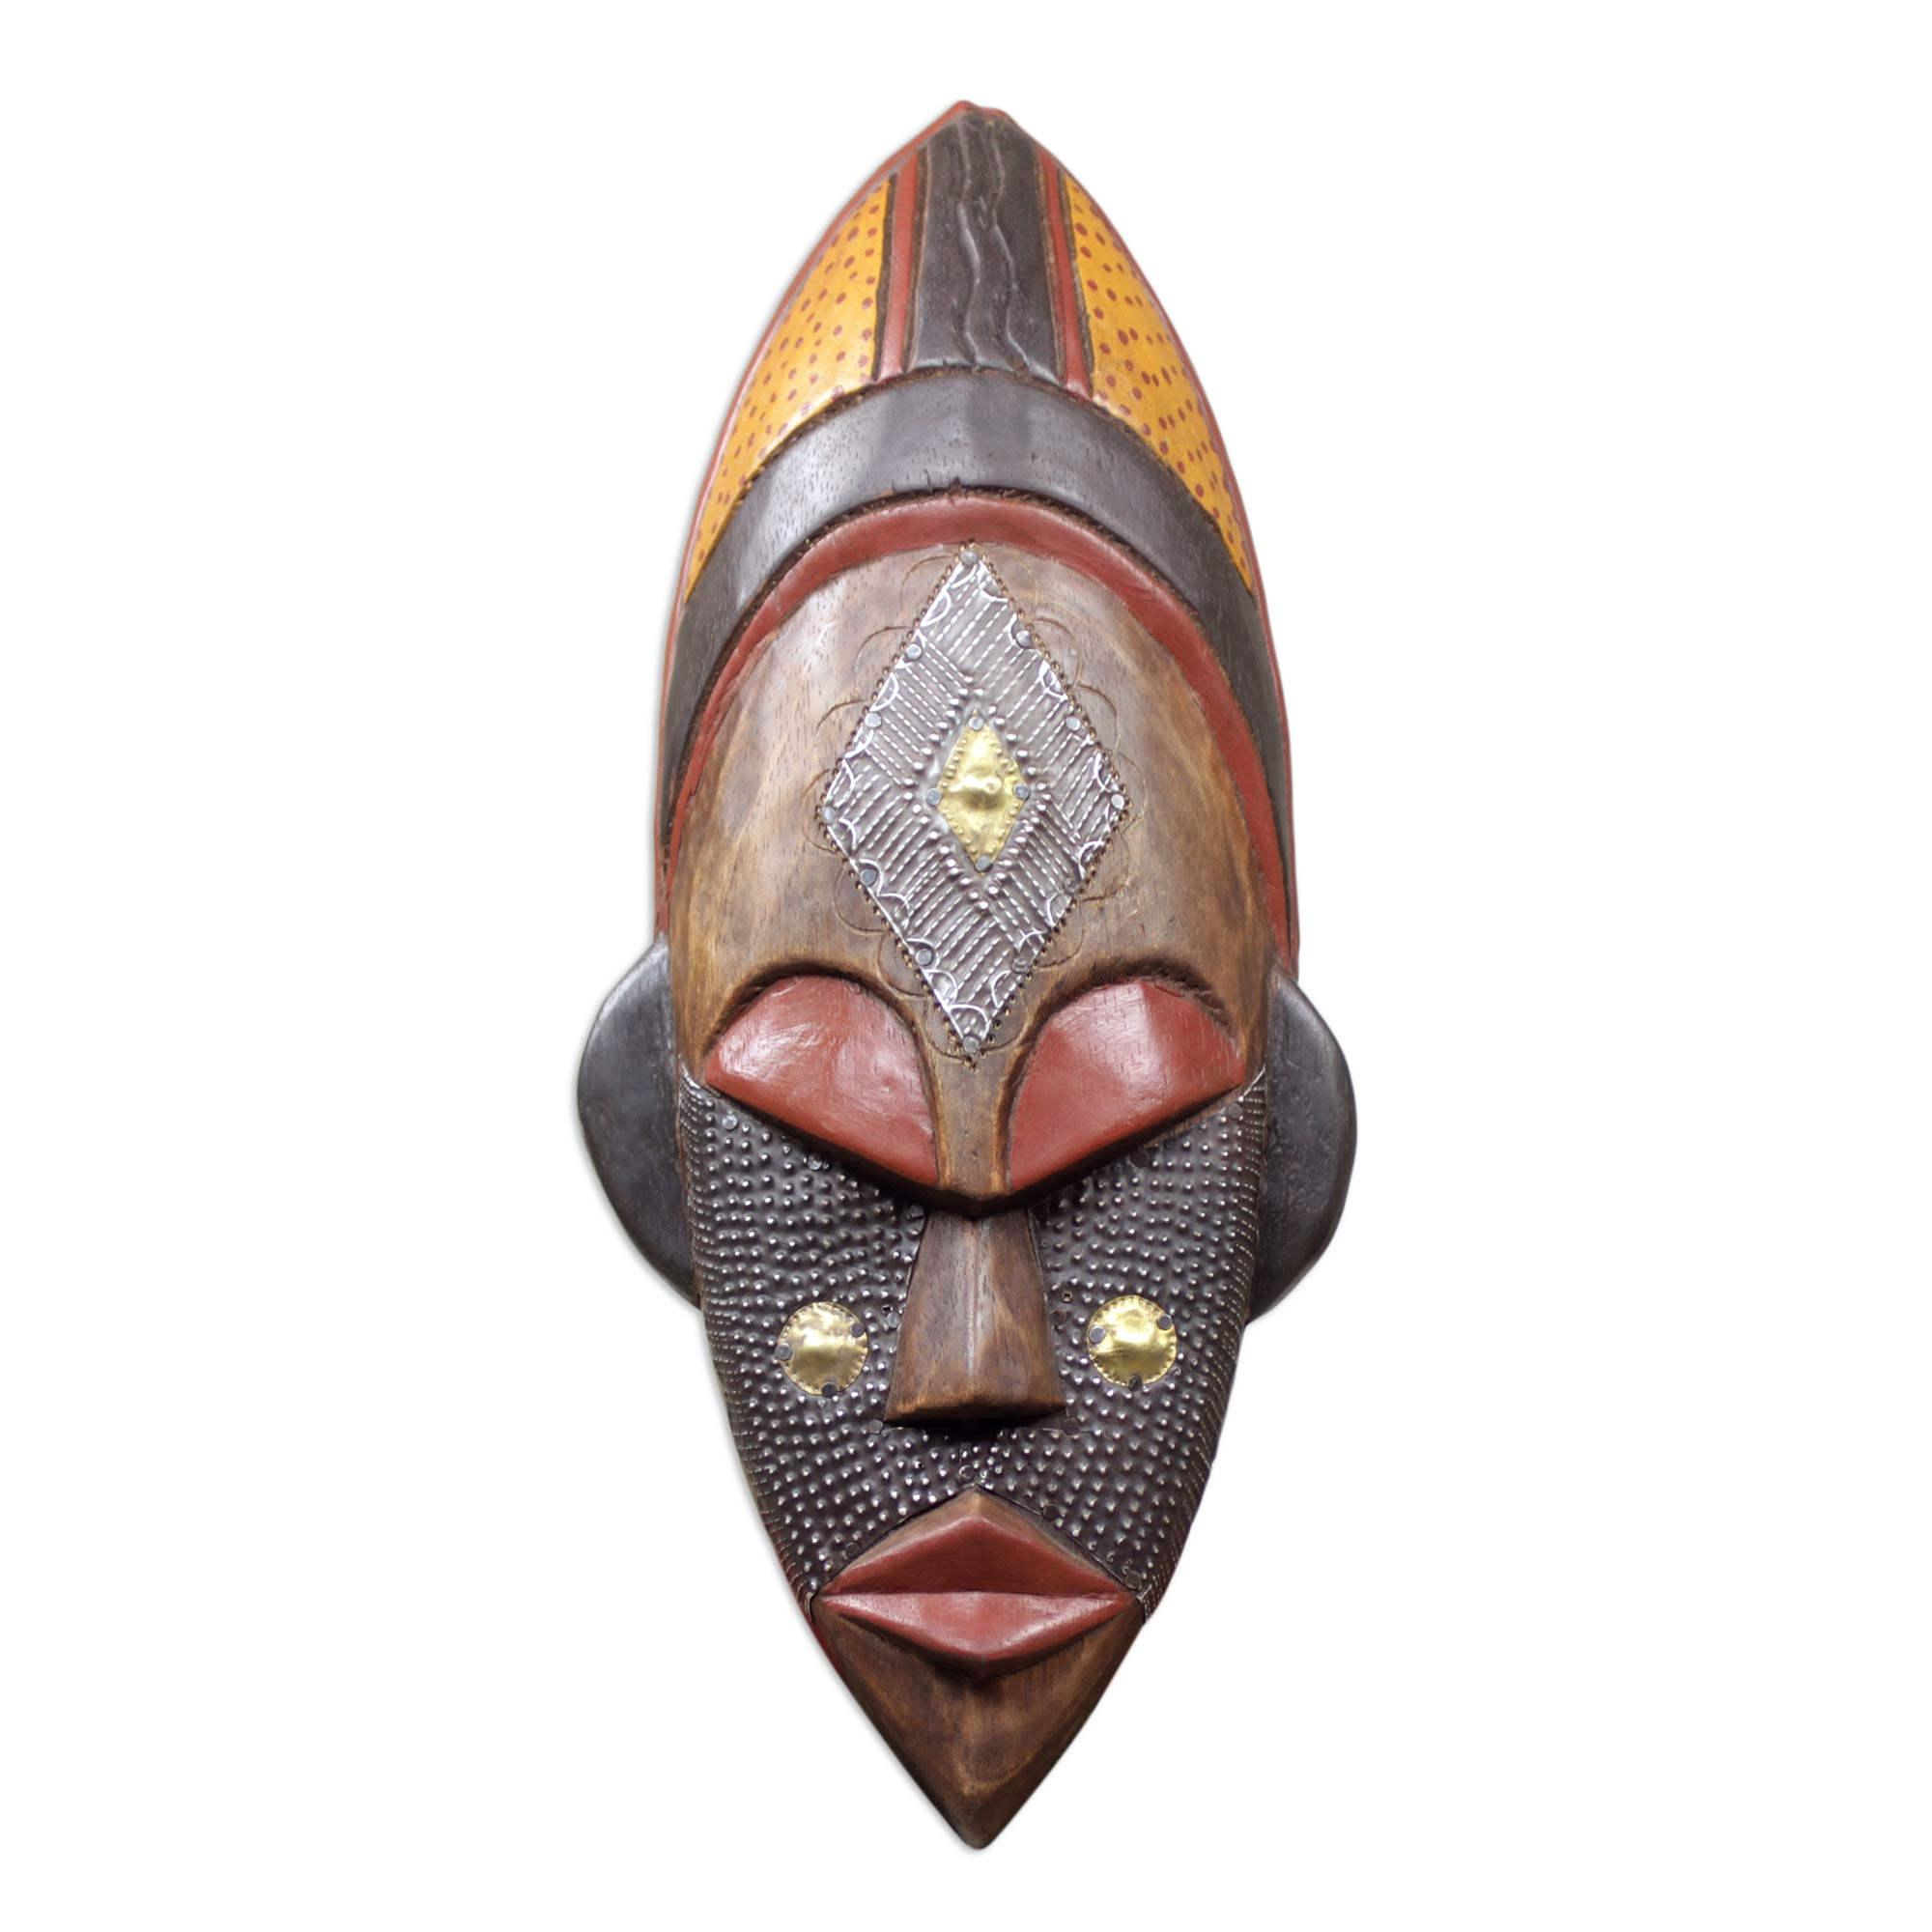
Mask Example

