Slide 1
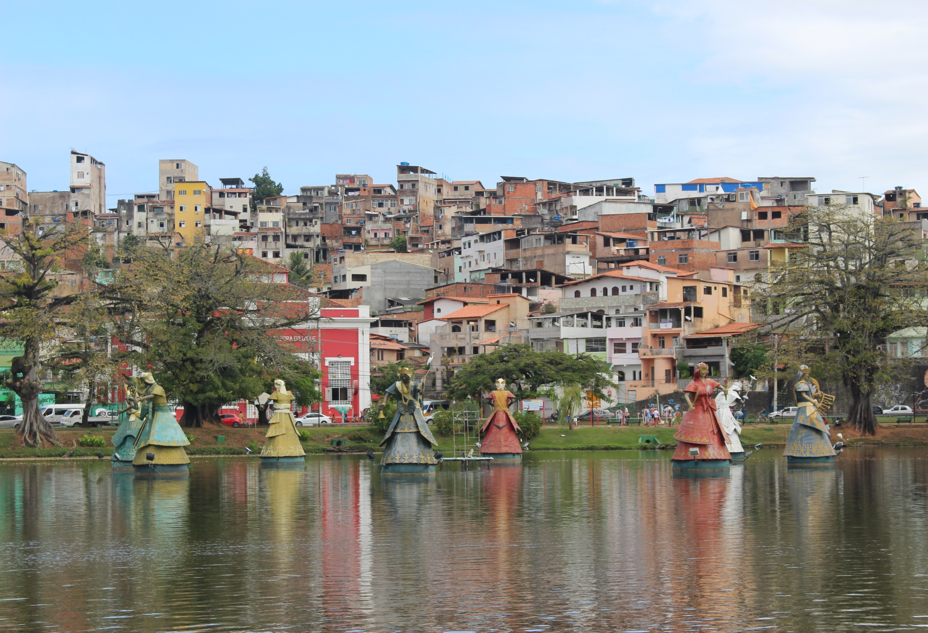
Lessons from Brazil

Slide 2
UDM/Fulbright Hays Group Project Abroad Curriculum Enhancement Project in Northeast Brazil
Lessons from Brazil:
UDM Faculty Reflections & Curriculum Projects Discussion

Slide 3
Presentation objectives
PART I
Discuss the GPA
Fulbright Hays programs – where you can find info on US Dept. of Ed and UDM’s websites
How UDM’s GPA fits our current strategic plan and mission
Brazil GPA’s purpose, goals, objectives, outcomes
Why Brazil?
Lessons from Brazil: Curriculum projects overview
PART II
Faculty feedback:
Curriculum projects being developed
Impact of GPA on teaching
Q & A

Slide 4
GPA Participants

Slide 5
Participants
UDM – 6
K-12 teachers - 7
Roy Finkenbine – CLAE/History
Ann Eskridge – CLAE/AAS/African American Literature
Alan Grigg – CLAE/Education
Renady Hightower – CHP/Health Services/Health Care Anthropology
Gail Presbey – CLAE/History & Philosophy
Lara Wasner – CLAE/Language & Cultural Studies
William Bowles – Western International High School, Detroit
Regina Elamri – Chandler Park Academy – middle & HS history/social studies (UDM alumna)
Kamasi Hill- Evanston Twp, IL; (UDM alumnus and UDJ) history, English, social studies
Karen Russell – DPS/Edison Elementary – all content areas
Erika Stowall – Detroit Academy of Arts & Sciences- K-8 Dance teacher
Rachael Walker – DPS Renaissance High School – 9-12 Art teacher
Alana Wynes – University Preparatory Academy – K-5 Art teacher

Slide 6
Fulbright Hays links at UDM: African Contributions to Contemporary Society Academic Affairs & Facebook pages
http://www.udmercy.edu/academicaffairs/fulbright/gpa/index.htm
https://www.facebook.com/udmbrazil/

Slide 7
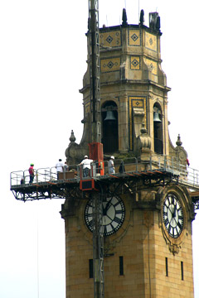
Transforming lives through Global Experiences.
Goal I: Drive Academic and Institutional Excellence
1.4.1
Expand Global Awareness, perspectives, and opportunities
Celebrate and broaden inclusive excellence
Goal II: Increase Enrollment, Retention and Graduation of Students
Provide excellent learning experiences that students will value and remember
Create a distinctive University learning experience
Goal III: Heighten the Distinction of the University
Strengthen the University’s local, national, and international reputation.
Increase alumni loyalty and involvement in the life of the University
Goal V: Amplify the University’s Dynamic Community Engagement
Promote the University’s knowledge experts and centers of excellence
Increase opportunities for collaboration to help achieve this goal.

Slide 8
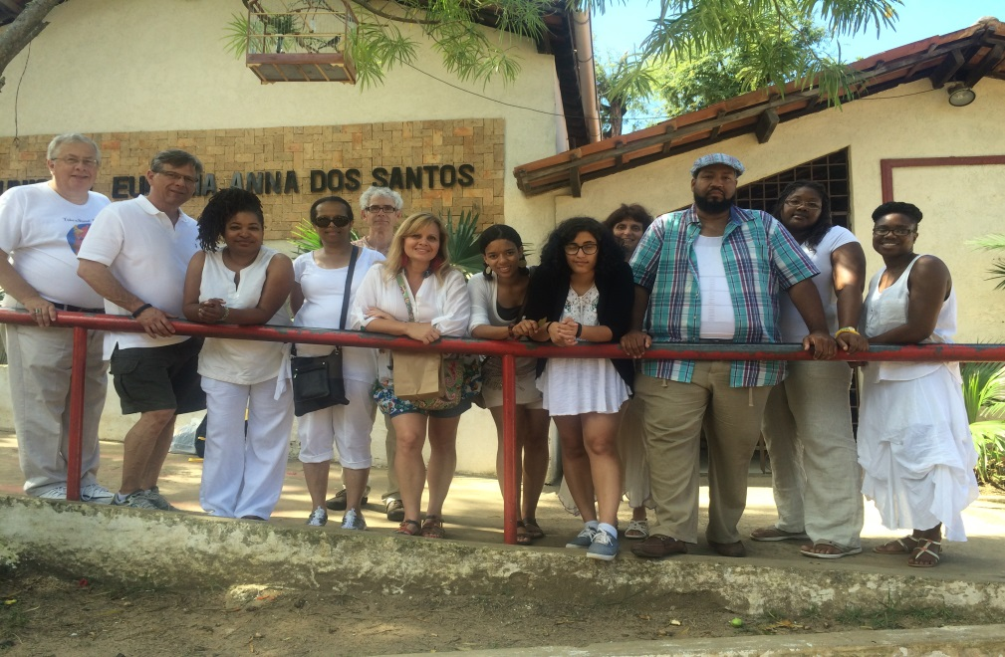
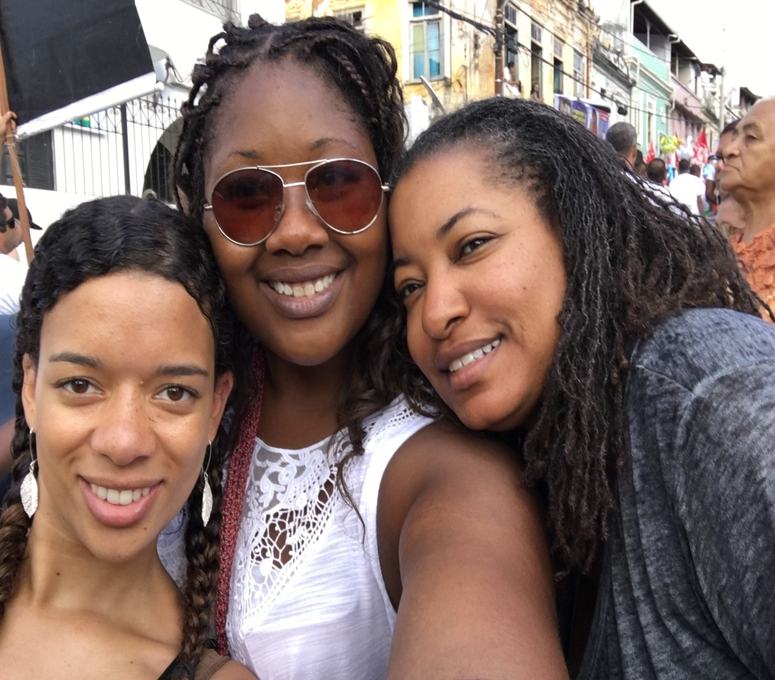
Collaboration: K-12 teachers UDM professors
Hola from Brazil!

Slide 9
Fulbright Hays program overview
Slides from the US Department of Education’s GPA webinar

Slide 10
U.S. Department of Education’s Fulbright Hays Group Projects Abroad Program Purpose
To support overseas training, research and curriculum development in modern foreign languages and area studies.

Slide 11
Area Studies
A program of comprehensive study of the aspects of a society or societies, including the study of their geography, history, culture, economy, politics, international relations, or languages.
Project participants may also be working in interdisciplinary areas such as business, health, social work, math, science, counseling, engineering, the environment and technology. If an educator or student is working in a variety of subject areas, s/he must spend the majority of his/her time working with eligible subjects.

Slide 12
FY 2015 Grant Competition
Estimated Available Funds: $1,361,000
Estimated Range of Awards: $50,000 - $125,000
Estimated Average Size of Awards: $80,058

Slide 13
Applicant Eligibility
Eligible Applicants—
Institutions of higher education;
State departments of education;
Private nonprofit educational organizations; and
Consortia of institutions, departments, and organizations.

Slide 14
Project Types
Short-Term Seminar
Curriculum Development
Group Research or Study

Slide 15
Curriculum Development Project
Project Features:
Acquire first-hand resource materials including artifacts, books, documents, educational films, museum reproductions, recordings, and other instructional material for curriculum development in modern foreign language and area studies;
Provide for systematic use and dissemination in the United States of the acquired materials; and
Resource materials include artifacts, books, documents, educational films, museum reproductions, recordings, and other instructional material.

Slide 16
Short-Term Seminar and Curriculum Development Project Details
Timeframe and Participant Numbers:
Minimum 4 weeks host country
Grant performance period: 18 months
4 weeks: 12 participants + Project Director = 13 minimum
6 weeks: 10 participants + Project Director = 11 minimum
8 weeks: 8 participants + Project Director = 9 minimum
Maximum Grant Award:
Up to $100,000 for 4-5 week projects*
Up to $110,000 for 6-7 week projects*
Up to $125,000 for 8+ week projects*
*equals time spent in host country

Slide 17
3 Phases to the GPA
Pre-departure programming – UDM: Feb - June
Overseas experience - July
Follow-up phase – August – December – project submission + 2 year presentation period to follow.

Slide 18
1. Pre-departure Phase (16 hours minimum)
Pre-departure preparation
Lectures on the country of study
Advanced reading materials
Pre-departure orientation
Guidelines on curriculum development
Discussions on daily living/traveling in host country
Team building
Team assignment and individual proposed project
Language training (we completed ½ of our language studies prior to departure at UDM)

Slide 19
2. Overseas Phase
Daily itinerary, very detailed
Academic lectures
Language study (Portuguese)
Field trips and cultural activities
Debriefings/evaluations
Travel arrangements and accommodations

Slide 20
3. Follow-up Phase
End of seminar evaluation
Staff development (workshops and conferences)
Curriculum or research projects and dissemination plans
Future outreach activities (collaboration, cooperation and networking)

Slide 21
Program Overview – Selection Criteria
Plan of Operation (20 points)
Quality of Key Personnel (10 points)
Budget and Cost Effectiveness (10 points)
Evaluation (20 points)
Adequacy of Resources (5 points)
Impact (15 points)
Relevance to Institutional Dev. (5 points)
Need for Overseas Experience (10 points)
Program Priorities (10 points)
TOTAL 105 points

Slide 22
Building the case for the need
UDM’s new Core thematic areas
UDM’s strategic plan
Detroit school’s/students’ needs
City of Detroit’s needs/recent bankruptcy – depleted resources
Enhancing partnership with local African American museums

Slide 23
Why Brazil?

Slide 24
Northeast Brazil: Geographical Importance
We selected Northeast Brazil – in the states of Bahia and Maranhão - as the area where participants conduct their research.

Slide 25
GPA Goal:
Goal:
To give participants multiple perspectives of the African-American experience through scholarly research and dialogue in Northeast Brazil to inform learning, build and enhance resources and internationalize their curricula in meaningful and measurable ways.

Slide 26
Project objectives
Build UDM curricular collaborations locally and globally
Build on past successful UDM experiences and relationships in Brazil
Enhance Brazilian Portuguese language resources at UDM
Gain intercultural competence by investigating cultural products, practices, and perspectives through the 5Cs
Leverage technology to record experiences, develop and store curriculum projects: e-Portfolios product
Generate and disseminate research and scholarly products

Slide 27
African continuities in NE Brazil
Northeast Brazil is where most African slaves were imported and where the African presence remains dominant.

Slide 28
Northeast Brazil
Bahia is the fourth most populous Brazilian state and has the largest African population; 80% of the population self-classify as brown or black.
In the capitol city of Salvador, with 2.7 million people, the culture is ruled by visible African ideals.

Slide 29
Programming in Brazil
Portuguese Language - with emphasis on the 3 modes of communication.
Lectures & Site Visits:
The Economic and Political Formation of Brazil
The Myth of Racial Democracy: Social Construction of Race in Brazil
The Black Movement in Brazil
The Bahia Street Girls Project
The Northeast of Brazil: Occupation and Land Issues
Racism, Discrimination and Religious Intolerance
African-Brazilian Religion and Symbolism
Candomble: The Reconstruction of African Civilization in Brazil
The African Contribution to Contemporary Brazilian Society
The History of African Presence: Reconstructing Civilizations
Quilombos Reminiscent Communities and the Demand for Land
The Slave Trade and its Impact on both sides of the Atlantic
African-Brazilian Women: Issues of Race and Culture
History of African-Brazilian Dance
Indigenous Musical Instruments of Brazil

Slide 30
African continuities in Salvador
Local cuisine, musical traditions, dance forms, Bloco Afro carnival groups, the acrobatic martial art of Capoeira, and the syncretic religion Candomblé are all openly celebrated. These and vibrant visual arts are all living testaments to the permeating African influence.

Slide 31
Salvador, Bahia
The old city of Pelhourino – whose name means “whipping post”.
We march with 1 million Salvadorans celebrating Brazil’s independence from Portugal on July 2.

Slide 32
Salvador, Bahia
At Ile Aye, we learned how African-centered education contributes to the community of Liberdade.
We learn about instruments – and drumming techniques – at musician Giba’s studio.

Slide 33
Salvador, Bahia
At the Steve Biko Institute
Learning about access to education and law 10639 – teaching African history in K-16 schools
At the CEAO Center,
Priestess Valdina explains the African religious traditions of Candomble and the mosaic of traditions:
Jeje, Angolan, Ketu, Ijexa (Yoruban)

Slide 34
Reconcavo Region
Many slave revolts were held in this region.
In Cachoeira, we meet with the Irmandade da Boa Morte.
We tour an MST site.
The MST movement is the largest social movement in S. America.

Slide 35
Teachers sharpen their talents at our site visits.
Farm overlooking St. Felix & Cachoeira – Erika Stowall
Pottery village near Jaguaripe – Rachael Walker

Slide 36
Sao Luis, Maranhao
Maranhão is one of the poorest Brazilian states, and one of the richest in African heritage; 73% of residents self-classify as brown or black.

Slide 37
Sao Luis, Maranhao
In Maranhão, participants visited an existing quilombo/mocambo site and participated in an African-inspired dance ritual.

Slide 38
Social, Political, Economic Comparisons
Comparisons were made where African experiences both converge and diverge.
By studying the slave trade in Brazil, U.S. educators now grasp the complexity of slavery from a more global perspective.
Race still plays a significant factor in income disparity in both countries.
Racial democracy in Brazil may be compared to democracy in the United States: both systems have allowed segregation to exist, and for social and income disparities to persist, and for people of color to be marginalized.
Black Lives Matter chapters began in Salvador and São Luis in 2016 to call attention to police violence against black youth in Brazil. 272,422 Brazilians of African descent were murdered from 2002-2010. Over half of those killings were by police. On average, the police kill 12,000 black Brazilians annually.

Slide 39
K-12 projects
Paulo Freire’s Pedagogy of the Oppressed and Hip Hop Culture in Northeast Brazil (high school mini-lesson and academic paper) - Hill
K-5 Unit Plan: The Family, Family Structure, and Community in Brazil - Russell
9-12 Unit Plan: Exploration of Afro-Brazilian History & Culture - Walker
6-12 Unit Plan: Who Am I? Exploring Identity through the Arts and Artistic Expression in Northeast Brazil - Wynes
6-12 Unit Plan: An Overview of Brazilian Culture and Society – Elamri
6-12 Exploring African Identity through Dance of the Orixas

Slide 40
Projects being developed UDM projects
Slave Rebels and Runaways in Brazil - Finkenbine
Using Cordel Literature to Create Narrative Stories in Rhythm and Rhyme - Eskridge
Affirmative Action & Access to Higher Education in the US and Brazil: A Comparative Analysis - Wasner
Indigenous Education in Northeast Brazil - Grigg
Race Does Matter in Community Health - Hightower
Injustice and Non-violent Responses in Northeast Brazil - Presbey

Slide 41
Performance Measures & Metrics
Individual e-Portfolio Graphic organizers (qualitative, quantitative) Annotated bibliography (qualitative) Journal entries (quantitative) Field notes log Discussion Board assignments (quantitative) | 100% of participants submit an original lesson/curriculum plan with authentic assessments with graphics to be stored in their e-Portfolios. 100% of participants contribute 3-5 new online, print, other resources to add to shared annotated bibliography that is stored in the e-Portfolio and on the Blackboard site. 100% of participants will integrate information from field notes into their curriculum designs during weekly workshops. 100% of students will have completed pre-departure assignments and responded to all prompts, responded to two peer questions per topics, and completed all assigned readings.
Lesson/Project Presentation Log CD, PD, faculty present at Colleague Development Day and Research Fair CD, PD, faculty present at at least one PD conference within two years. | 100% of students will log all lessons presented at school that result from this project. 100% of students will log at least one presentation at district, profession venue. 100% of UDM participants are expected to present their research/project at at least one conference within two year.

Slide 42
Impact on Participants
Through hands-on experience, I was able to explore, hear, interact, discuss, create, perform…and better understand the interconnectivity that exists between all cultures, histories, and people.
Professionally, this was a life changing experience that will serve as a foundation for my developing more in the cultural and global health arena. I look forward to sharing and presenting what my experiences have taught me at professional conferences and associations which I am a participant of.

Slide 43
PART II – Faculty Reflections
Discussions about the impact of the experience and the curriculum projects being developed

Slide 44
Read more, see more!
https://www.facebook.com/udmbrazil/

