Slide 1
STREET ART:
Graffiti in Brazil by Alana Wynes
Notes:
I am thinking about doing a project/unit plan on identify, place, and race with my 4th and 5th grade students.

Slide 2
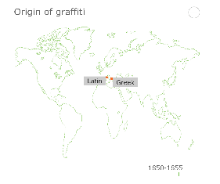
What is Graffiti?
“Markings, as initials, slogans, or drawings, written, spray-painted, or sketched on a sidewalk, wall of a building or the like (Dictionary.com)
Originated from Latin/Greek
Comes from the Italian word ‘graferre’
which means to scratch on a surface
A form of Public Art
Part of our everyday visual experience
Cultural/Diverse/Influential
Often Political (Protest Art-sends a message)

Slide 3
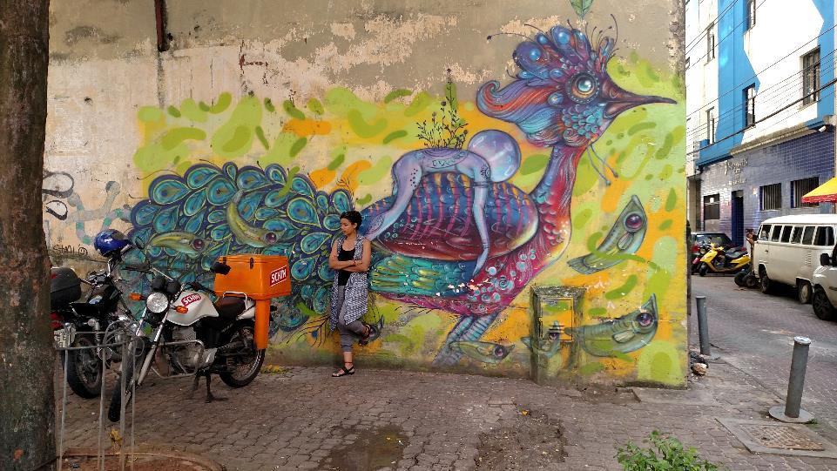
Documentation of Graffiti in
Salvador de Bahia, Brazil 2016

Slide 4
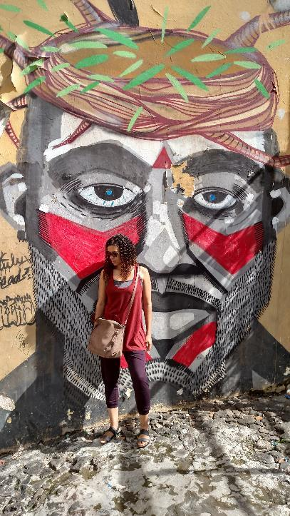
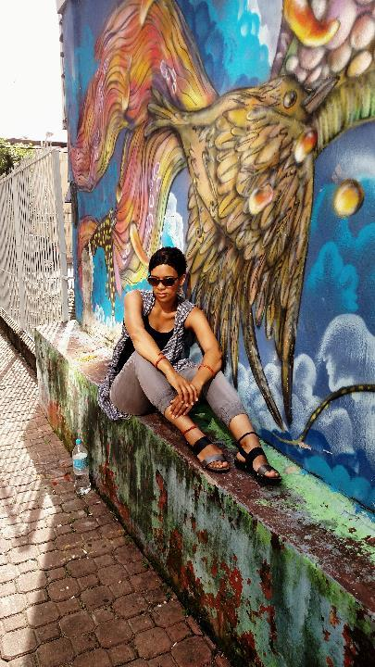
Ms. Wynes
Exploring Graffiti Art in
Salvador de Bahia,
Brazil

Slide 5
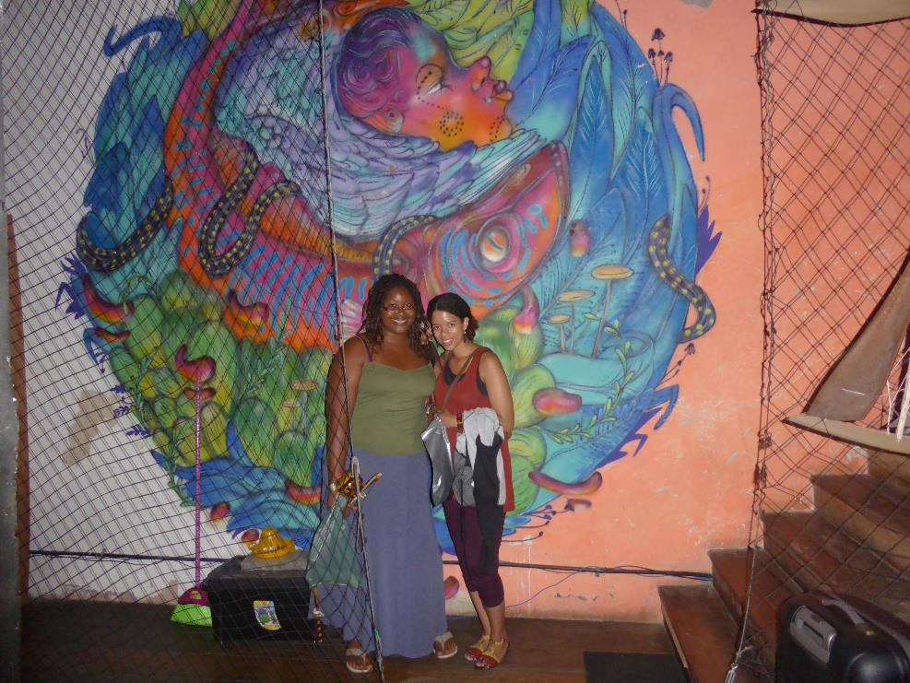

Slide 6
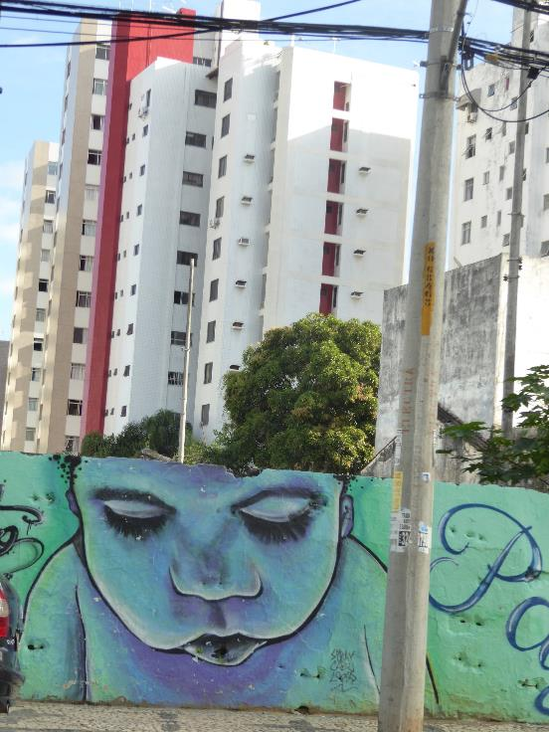

Slide 7
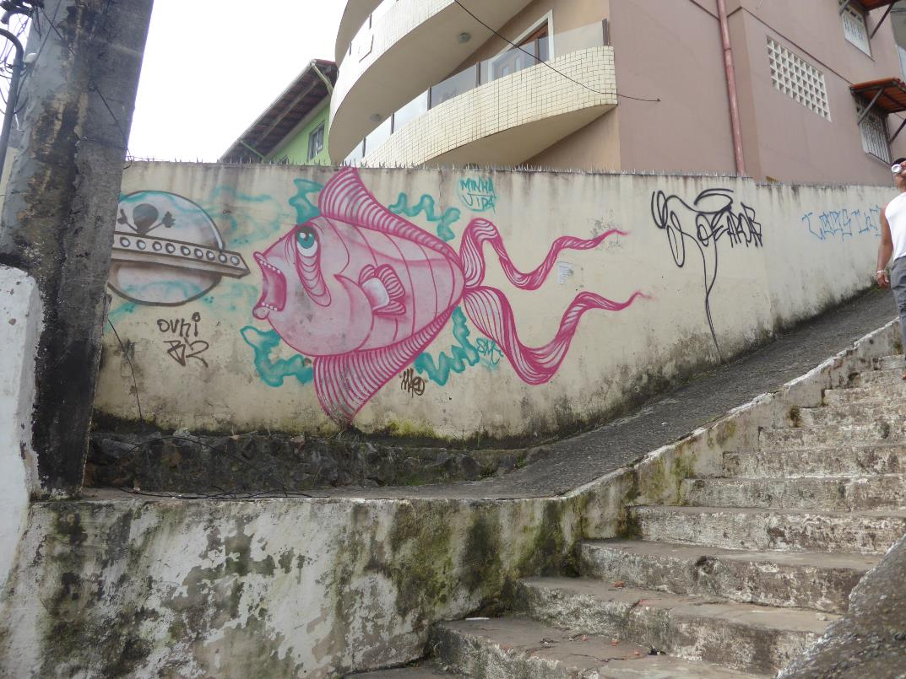

Slide 8
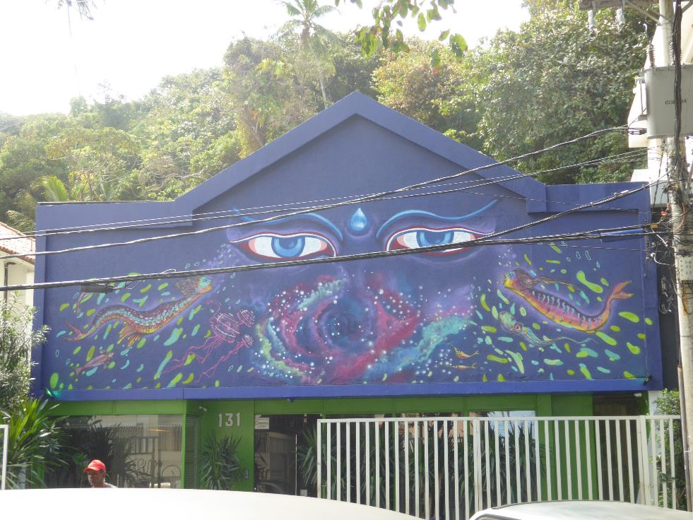

Slide 9
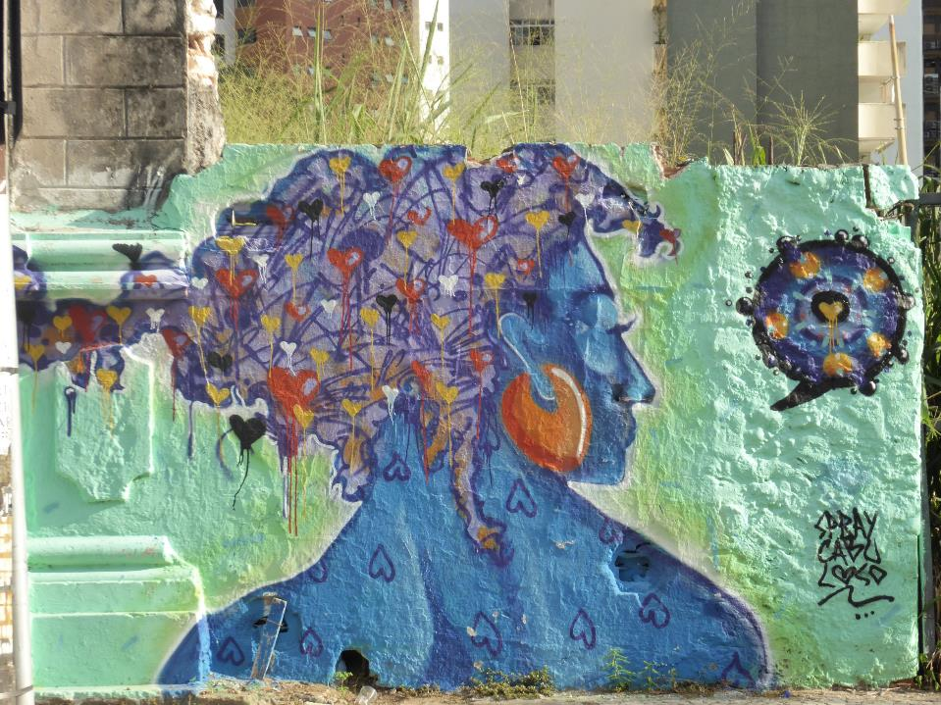

Slide 10
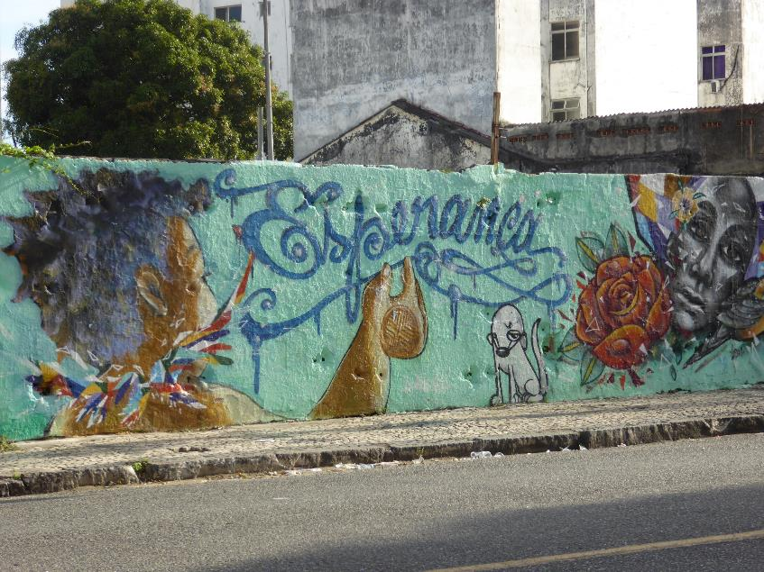
“Hope”
Notes:
“Esperanca” means hope in Portuguese

Slide 11
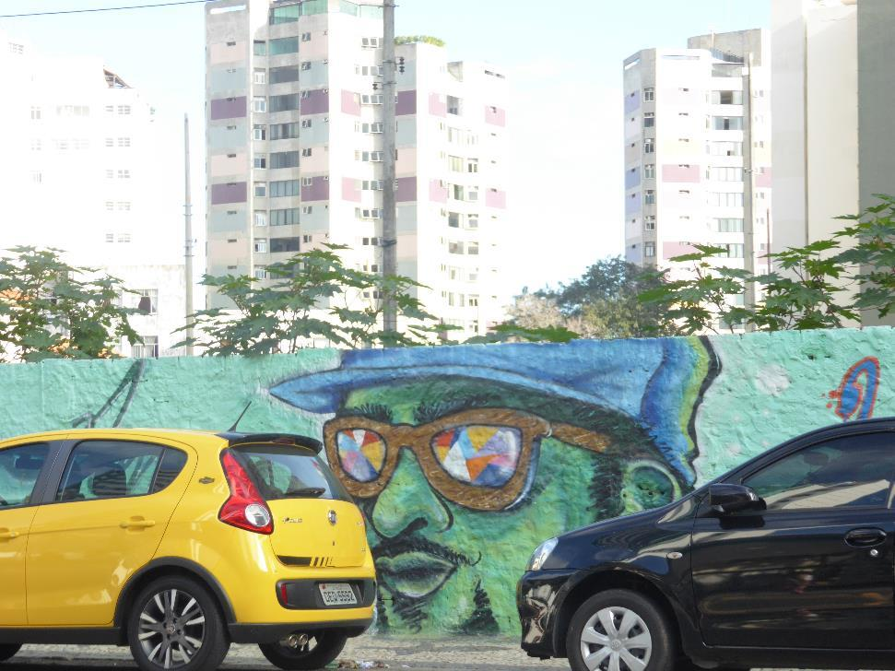

Slide 12
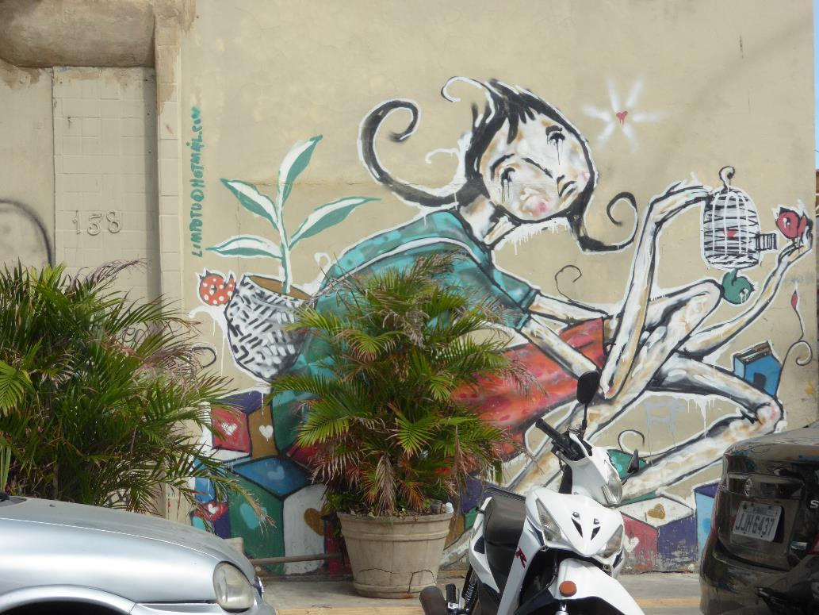

Slide 13
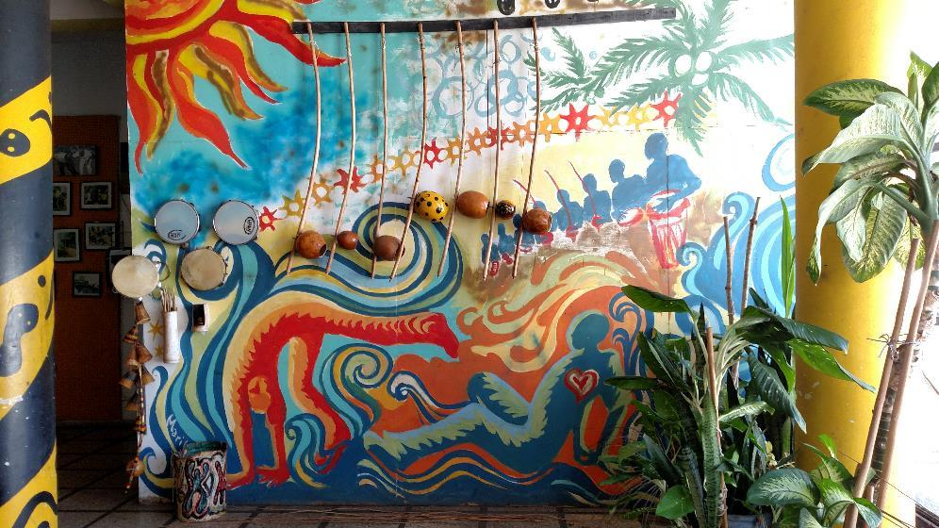
Capoeira Studio in Salvador, Brazil
Notes:
Graffiti in a Capoeira Studio (Martial Arts) studio

Slide 14
Guiding Questions
What is the purpose of Graffiti?
Do you think Graffiti accomplishes its goal?
What qualifies art to be public art?
Do you see any controversial themes within these works?
How is Art able to send a message without words?
Notes:
I hope to visit schools, eventually partner with one school in order to stay in communication upon return to the U.S. I am looking into Skype as being aresource for us to stay in communication. As these are the guiding questions for my students, they are also the guiding questions for myself before, throughout and after this trip.

Slide 15
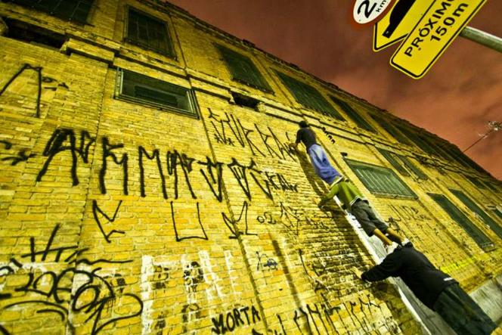
Graffiti
As a Response!
The Power of Art
Notes:
Since it first arrived in the city as a response to the new movement that began in New York in the 1970s, the new art expression came to Rio and was initially carried out by kids, punks, students and professional artists. These people marked the walls with their names or their thoughts on the military dictatorship, racism, social inequality, and the rivalry between Fluminense and Botafogo football clubs. However, although NY is considered to be the home of graffiti in America, Brazil was a pioneer is something called “Pixação” – a pre-form of graffiti that consisted of tagging done in a distinctive, cryptic style, mainly on walls and vacant buildings. Pixação, also known as “wall writings”, first began appearing in the 1940s and 50s as political statements written in tar and were often written in response to the slogans painted by political parties across the streets.
The production of street art, particularly forms of muralism and graffiti, accelerated at an unprecedented pace from the mid-1980s in Brazil, coinciding roughly with the period of democratic transition, economic opening and the import of hip-hop style from the United States.
Article Reference: http://www.widewalls.ch/when-graffiti-matters-the-most-brazil-feature/

Slide 16
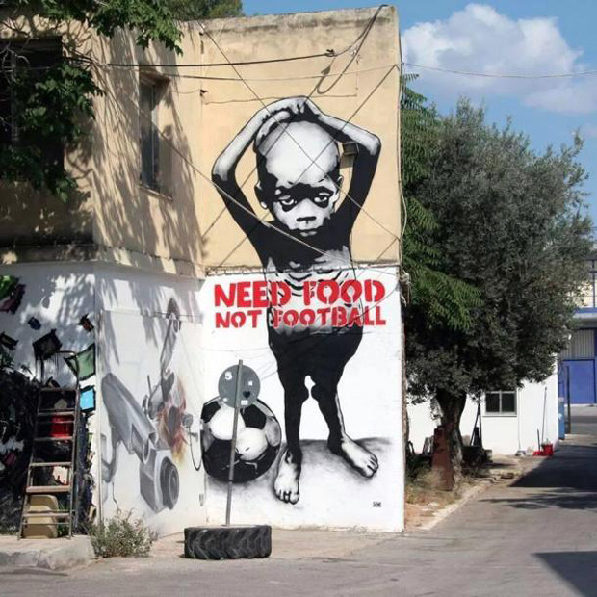
In March 2009, the Brazilian government passed Law 706/07 which legalized Graffiti
Graffiti piece in
Rio de Janeiro, Brazil

Slide 17
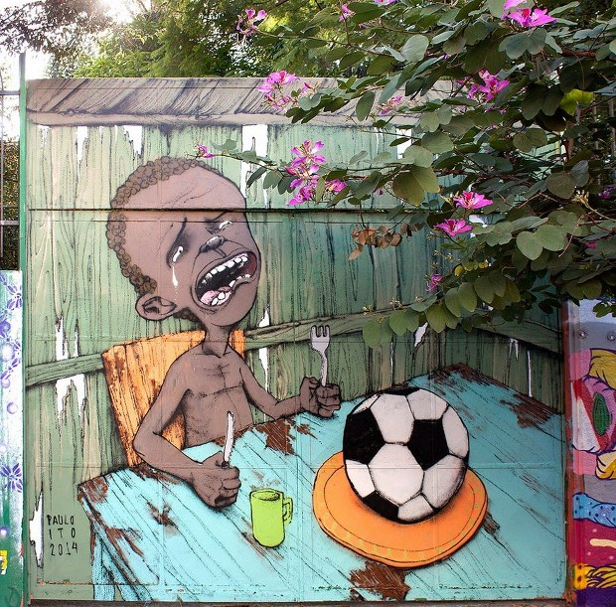
Graffiti by
Brazilian street artist Paulo Ito depicting a starving child with nothing to eat but a football
(Sao Paulo)
What’s going on in this picture?
What do you see that makes you say that?
Notes:
I want to teach students how to self-reflect and translate that reflection into a progressive voice. I feel like our students have so much they want and wish to say but just no way to say it. Showing students art from Brazilian artists that accomplish voice/a message through art will hopefully inspire them to create their own work of art that explores social justice issues. Here is one image where a Brazilian street artist uses their talent to protest Fifa and the World Cup in 2014
Graffiti by Brazilian street artist Paulo Ito depicting a starving child with nothing to eat but a football. Photograph: Nelson Almeida/AFP
He painted the image on the doors of a Sao Paulo public schoolhouse .
Link: https://www.theguardian.com/artanddesign/gallery/2014/jun/09/brazils-anti-world-cup-street-art-in-pictures

Slide 18
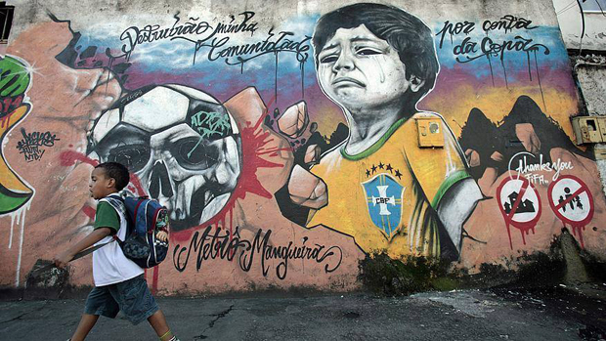
What’s going on in this picture?
What do you see that makes you say that?
Notes:
“Destruction of my community because of the cup (World Cup)

Slide 19
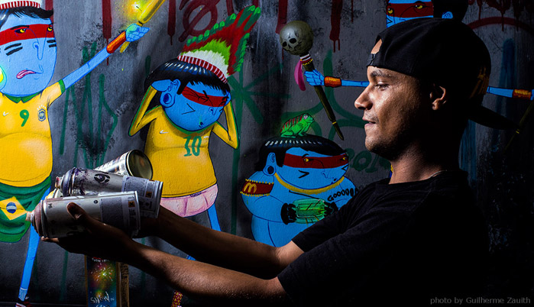
Fabio de Oliveira Aka “Cranio”
From Sao Paulo, Brazil
Themes found in his work:
Consumerism, corrupt politics, and environment issues
Notes:
“Meet Cranio: a Brazilian street artist who is fighting to keep traditions alive. His characters are dressed as aboriginals. He uses the color blue for their skin tone, which gives them an alien-like quality. Cranio conveys a message of universal misunderstanding of the indigenous culture, while merging old traditions with modern day events in order to raise awareness.…The contrast between their traditional clothing and the fact that they are wearing shoes is a social commentary on consumerism. He even purposefully uses universally recognized brand logos.”
Reference:
http://respect-mag.com/2012/09/street-art-dont-forget-to-remember-the-indigenous/

Slide 20
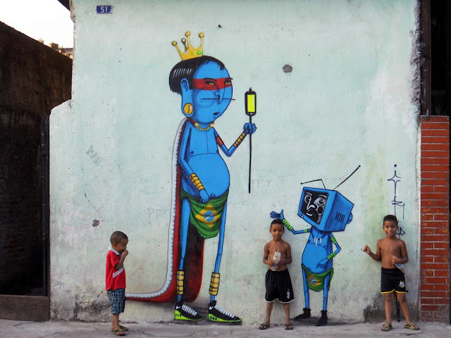
What’s going on in this picture?
Notes:
Video of his work:
https://www.youtube.com/watch?v=P5a_N2lq9Vo
https://www.youtube.com/watch?v=Uvq1WHtn_PM

Slide 21
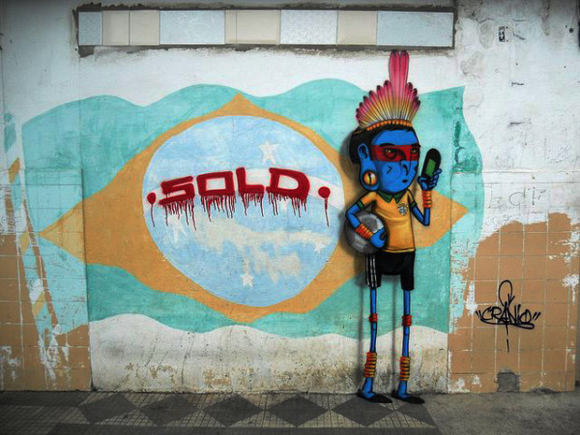
Notes:
What’s going on in this picture?
What do you see that makes you say that?

Slide 22
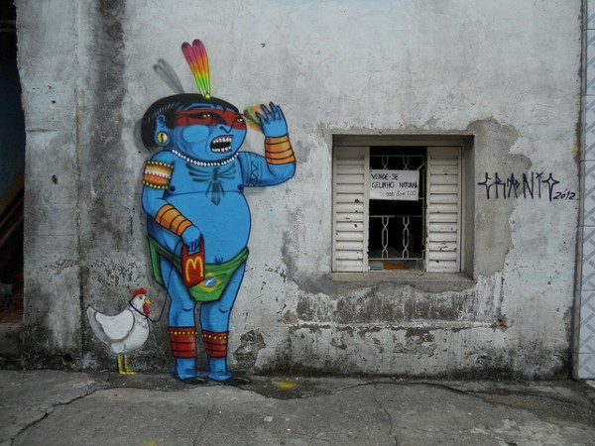
CTRL + Click to watch video of Cranio at work
https://www.youtube.com/watch?v=Uvq1WHtn_PM
Notes:
What’s going on in this picture?
What do you see that makes you say that?
Discuss image above and video. Ask students what they think?

Slide 23
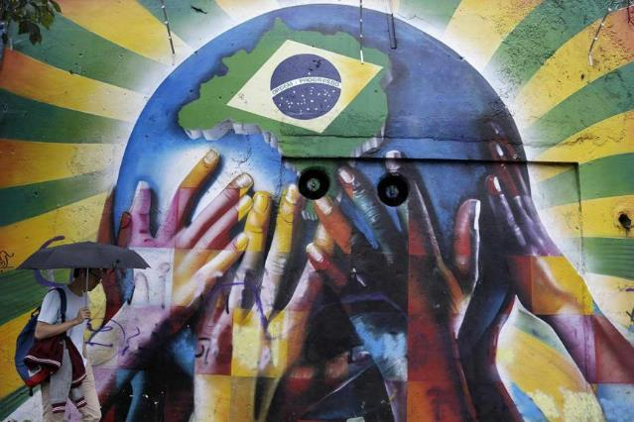
Building Community Through Street Art
Brazil

Slide 24
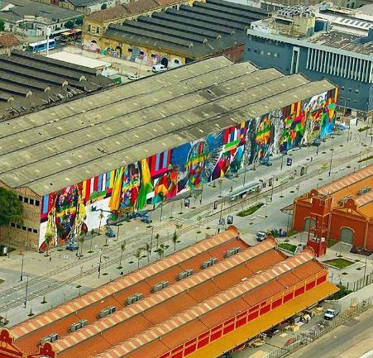
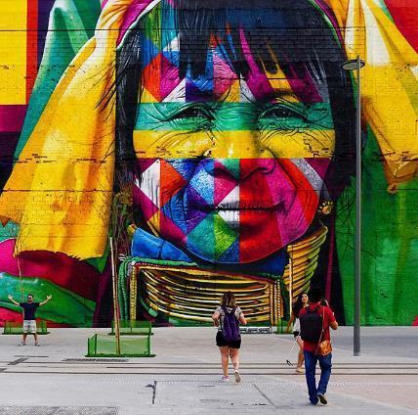
Artist:
Eduardo Kobra
from Sao Paulo, Brazil
Las Etnias
(The Ethnicities)
Painted for the 2016 Olympics in Rio
Notes:
The mural, titled Las Etnias (The Ethnicities), stands a staggering 50 feet (15 metres) tall and can be found in Rio’s port district. It features five faces from five different continents that represent both the five Olympic rings as well as the cultural diversity of the games. Kobra, 40, from Sao Paulo, worked on the piece for two months, and during that time he used 100 gallons of white paint, 400 gallons of colored paint and 3,500 cans of spray paint. If confirmed by the Guinness Book of Records, Kobra’s mural will be the world’s largest mural completed by a single man.
“These are the indigenous people of the world,” says Kobra on the Rio 2016 official website. “The idea behind it is that we are all one. We’re living through a very confusing time with a lot of conflict. I wanted to show that everyone is united, we are all connected.”
(Representing The Karen from Thailand)

Slide 25
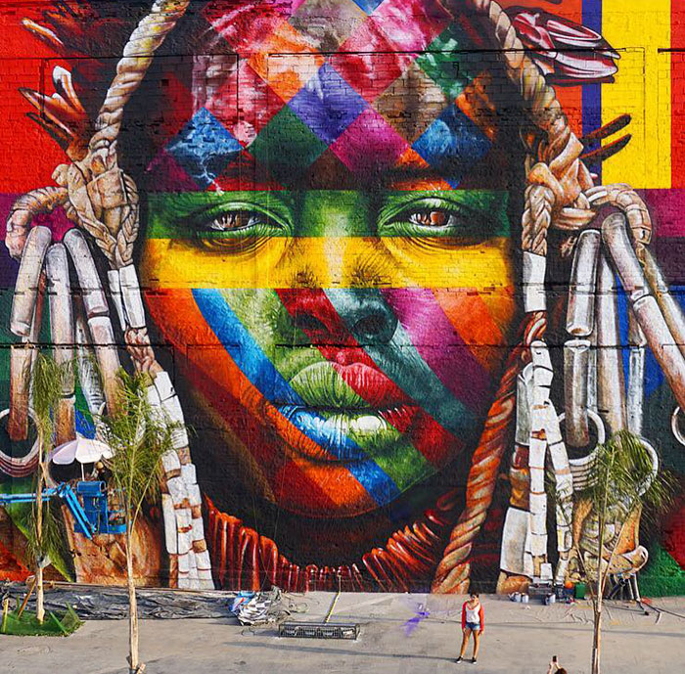

Slide 26
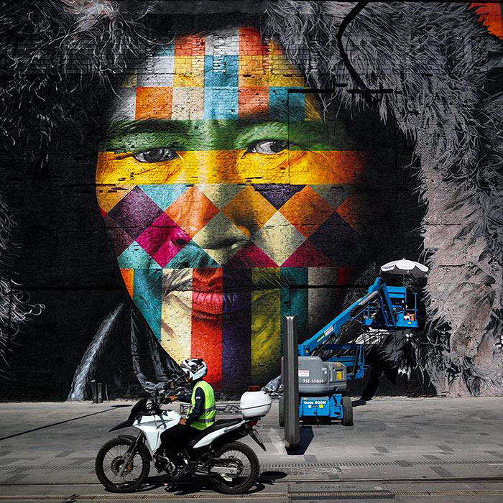

Slide 27
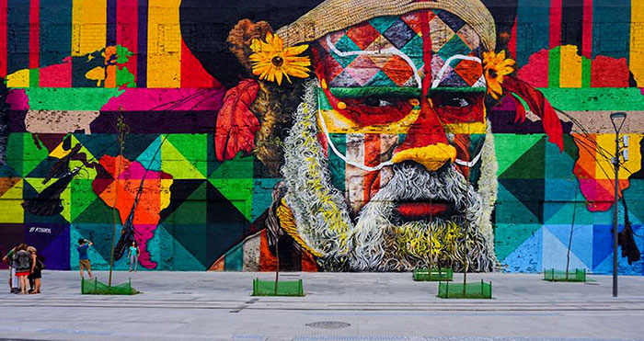
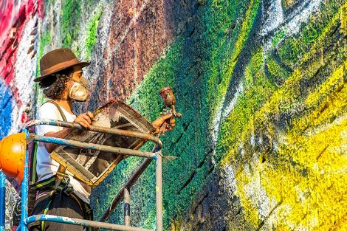
What message may the artist be giving?
Notes:
Kobra and his team of four guest artists whitewashed the building, marked a grid pattern on the concrete, and then, supported by seven hydraulic lifts, used more than 1,500 liters of colored paint and 3,500 cans of spray paint to depict the 50-foot-tall, 620-foot-long artwork.

Slide 28
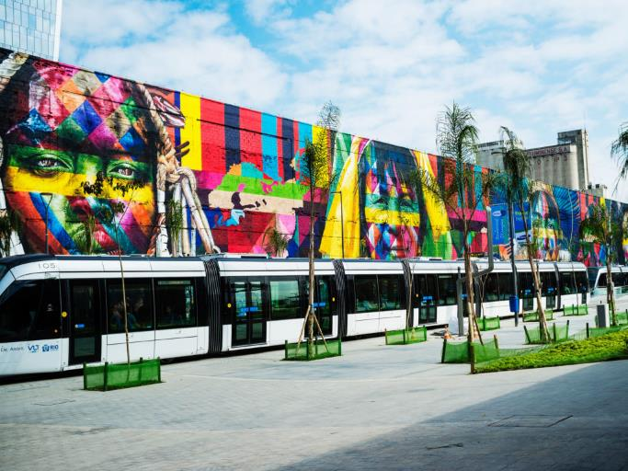
Kobra worked on the piece for 3 months/10 hr work days, and during that time he used 100 gallons of white paint, 400 gallons of colored paint and 3,500 cans of spray paint. Kobra’s mural is in the process of being considered by the Guinnees World Book of Records as the world’s largest mural completed by a single man.
Ctrl + Click for Video of Mural In Process
Notes:
The work, entitled Etnias, covers more than 30,000 square feet of a formerly abandoned warehouse in Rio’s newly reinvigorated port district. Using a wild quiltwork of brightly colored geometric shapes, it portrays the faces of five indigenous men and women from five continents. (The five Olympic rings inspired the number of subjects.) The portraits depict the wizened faces of members of the Mursi, from Ethiopia; the Kayin, from Thailand; the Supi, from Europe; the Huli from Papua New Guinea, and the Tapajos, from the Americas.
“I wanted to show that everyone is united, we are all connected,” says Kobra.
Reference Links to Articles:
https://www.wired.com/2016/08/epic-olympics-inspired-mural-named-worlds-biggest/
http://www.boredpanda.com/world-largest-mural-street-art-las-etnias-the-ethnicities-eduardo-kobra-rio-olympics-brazil/

Slide 29
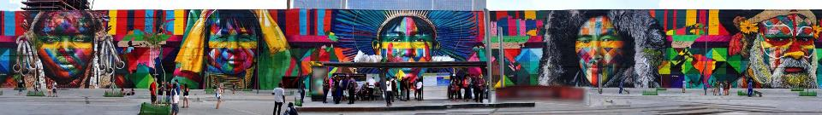
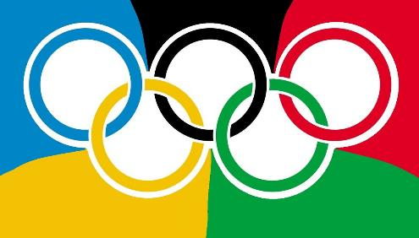
Is there a connection? What do you notice?
Notes:
History of Olympic rings:
Since 6 continent model was more prevalent in Europe in the early 20th century, founder of the modern Olympic Games Pierre de Coubertin designed an Olympic flag with 5 interlocked rings and not with 6.
In fact, he chose these colors, because when combined with the white background, they represented the colors of the flags of all nations at that time, without exception.
From left to right, the cultures represented are the Ethiopian tribe Mursi (Africa), the Kayans in Thailand and Myanmar (Asia), the Tapajós of Brazil (America), the Supi people in Europe (Europe), and the Huli people of Papua New Guina (Australia and surrounding islands)
“We Are All One”
“We Are All Connected”
Reference: http://www.planetsmarty.com/2016/04/story-of-olympic-rings-free-printable.html

Slide 30
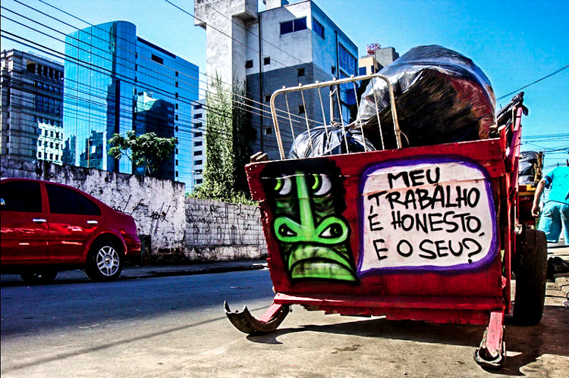
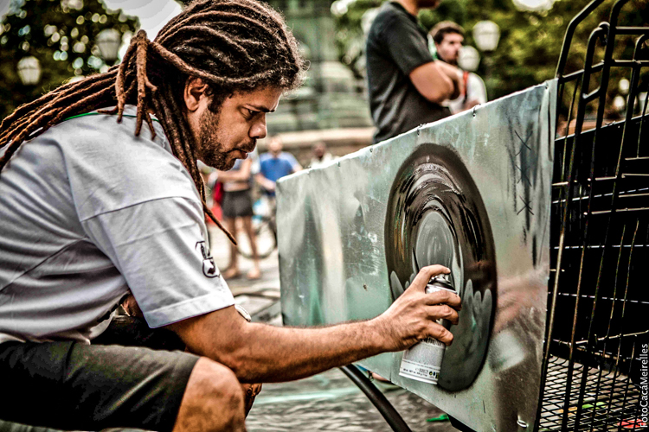
Thiago Mundano
Brazilian street artist, turning trash carts into art to send a powerful message
“My work is honest,
and yours?”

Slide 31
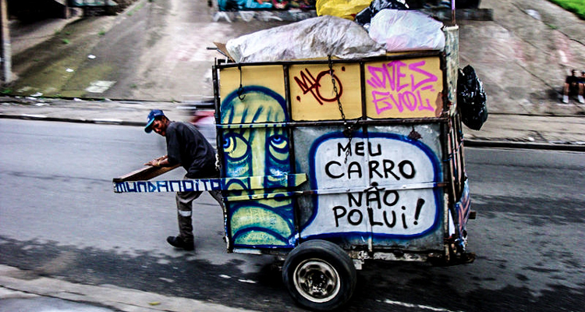
“My car doesn’t pollute!”
Notes:
“My car doesn’t pollute”

Slide 32
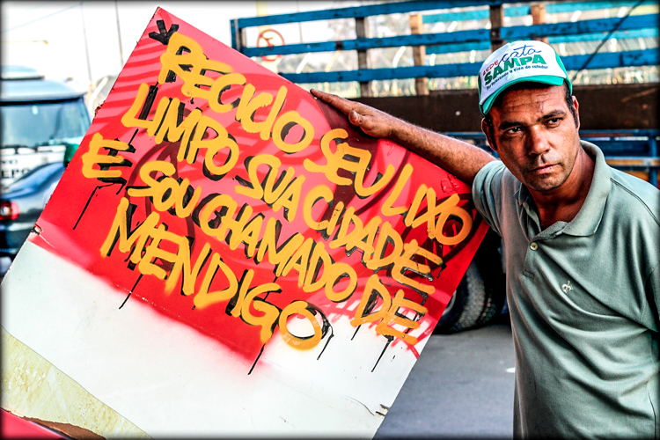
“I pick up your waste, clean your city, yet I am called a beggar.”

Slide 33
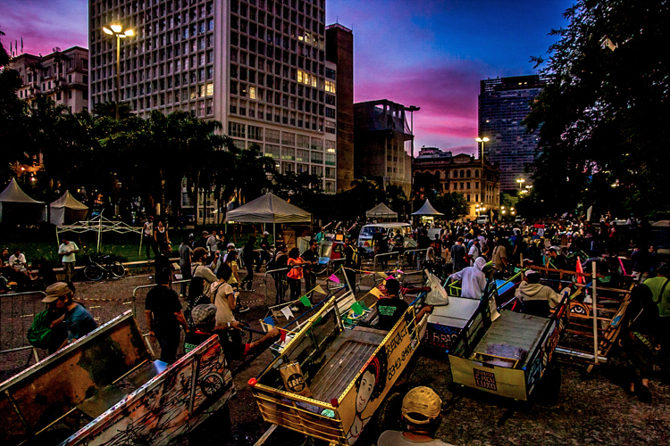
Artist Thiago Mundano transforms trash carts to bring attention to not only the massive amounts of trash but also to the workers-with political and environmental undertones.
Brazil generates more than 200,000 tons of trash daily, with approximately 1 million trash collectors known as “catadores”
Notes:
Artist Thiago Mundano transforms trash carts to bring attention to not only the massive amounts of trash but also to the workers-with politial and environmental undertones. Brazil generates more than 200,000 tons of trash daily, with approximately 1 million trash collectors known as “catadores”

Slide 34
Now it’s Your Turn…
use public art to send a message
Think…
If you could send any message to the world through Graffiti using only 1-2 words,
what would it be?
Notes:
Students will create a series of small scaffolding projects and one larger final project as a culminating. My goal is to teach students about history, economics, culture, and language while teaching them art. This project will fully develop and most likey change quite a bit while in Brazil and after Brazil.

Slide 35
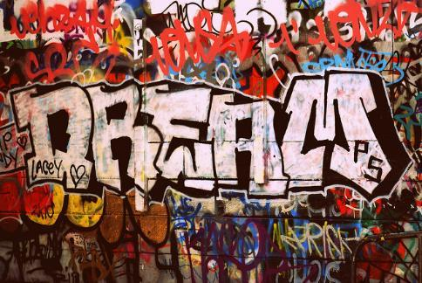
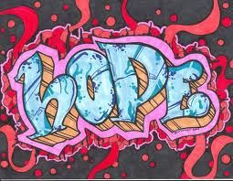

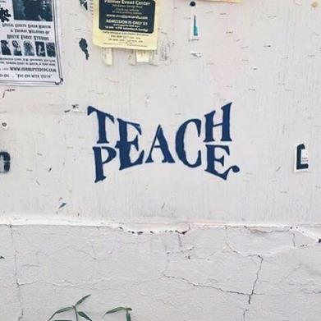
Examples…

Slide 36
Let’s Create!!!
Create a sketch of your word(s) using any style of Graffiti lettering (Fill the entire paper)
Incorporate symbolism/imagery as a background into your graffiti drawing to emphasize your “message”.
3) Select a set of colors that aesthetically work well
together.
On a new sheet, create your final piece of Graffiti
using markers, sharpies, crayons, and/or colored
pencils.
5) Color in all letters evenly.
6) All Graffiti pieces will be installed together in the
school hallways to spread student messages.

Slide 37

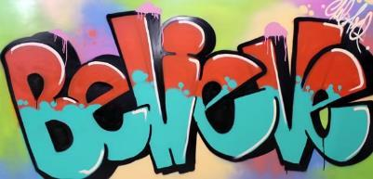
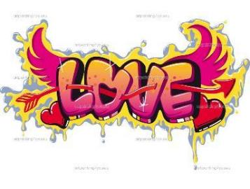
Tips For Your Graffiti Work:
Exaggerate Letters
Make letters same thickness
Add multiple colors in each letter
Make it colorful/repeat colors
Make it meaningful
Overlap letters/images
Add borders around your entire word
Add shadowing/3-D effect to each letters
Draw symbols/pictures partially behind, in front of, or throughout your word(s)

