Slide 1
Marking the text

Slide 2
Number the paragraphs
Number the paragraphs in the reading (any time there’s an indent). As with page numbers, paragraph number will act as a reference so that you can easily refer it to later.

Slide 3
Circle key terms, cited authors, and other important words/numbers
You might circle: key concepts, lesson-based vocabulary, names of people, names of places, dates, names of historical events, numbers, repeated words, and anything relevant to to the reading purpose.

Slide 4
Underline author’s claims, evidence, and information relevant to reading purpose
Relevant information might include central claims, evidence, facts about a person, place, thing, or idea, description of a person, place, thing, or idea, cause and effect relationships, repeated words, and anything relevant to the reading purpose.

Slide 5
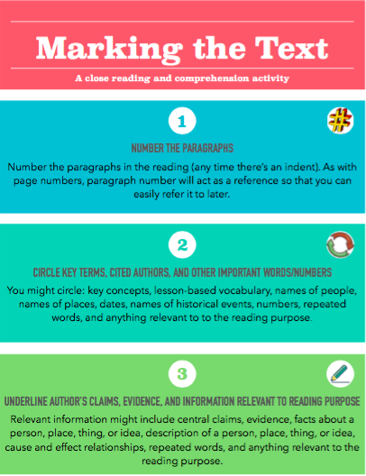

Slide 6
Jigsaw strategy
Step by step

Slide 7
Step 1
Students will be assigned to a Jigsaw Expert Group
Step 2
One student will be assigned the Leader
Step 3
Each group member will be assigned a segment of the assignment

Slide 8
Step 4
Students will read over their section ONLY
Step 5
Students will meet with other students who had the same segment of the assignment to discuss that segment ONLY
Step 6
Students return to their original Jigsaw group

Slide 9
Step 7
Students will present their segment to their Jigsaw Group (group members are encouraged to ask questions!)
Step 8
Student leader will keep their group on task
Step 9
Teacher (me!) will be walking around to observe

Slide 10
Step 10
Quiz on the material presented in the groups!
Questions? Comments? Clarifications? Concerns?

